Slide 1
TO the Reformation
New politics in Machiavelli and Shakespeare: emphasis on skill and calculation.
A certain loneliness: premise is that we start as strangers to each other.
An emphasis on the power of knowledge.

Slide 2
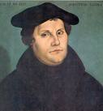
Martin Luther
1483-1546

Slide 3
At the same time: the Reformation
In 1517 the 95 Theses put up by Luther
in June 1520 he was called on to recant 41 of them. His books were burned. Luther burned the papal bull and was excommunicated. In his response to this Luther argues
Scripture alone is true Lord and Master of all writings and doctrines on earth
we may boldly confess whatever we think true, independently of what Church councils say
no earthly authority can claim the last word
Luther was called on to recant this and called before Diet at Worms
Famously he ended his defense with “I cannot and I will not retract anything, since it is neither safe not right to go against conscience. I cannot do otherwise, here I stand, may God me, Amen.”

Slide 4
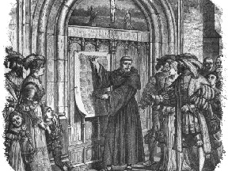
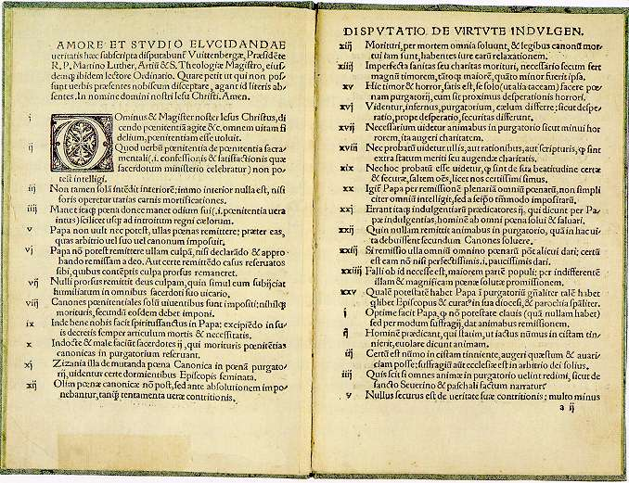
The 95 Theses - 1517
Church door in Wittenberg (where Hamlet studied…)

Slide 5
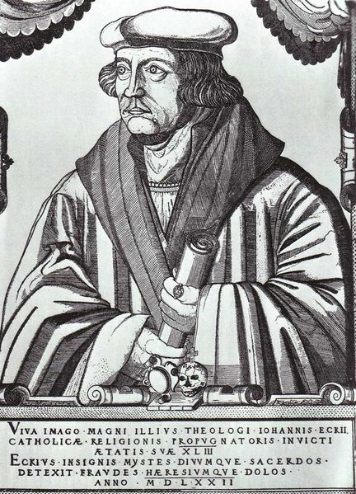
The debate at Worms, 1520 Johannes Eck Exsurge Domine

Slide 6
NOTE these points:
everyone a priest
word of God -- importance of Scriptures
literal reading
anti-hierarchical at some deep level
everyone has it within him (sometimes her-) self to know what is right.
To the claim that this produced anarchy, he responds was that if you looked hard and honest into your soul, you could find there an approach to the unrealizable truth of God. Others were on hearth to help one look.
What was a peculiar quality of some men in Shakespeare and an unusual quality in Machiavelli is in Protestantism seen to be possibly in everyone.
Raised a political problem: what is the role of government
Luther had maintained the role of the government as repressive.
Peasants War
govt is still there to stop people from killing each other

Slide 7
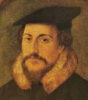
John Calvin, 1509-1564

Slide 8
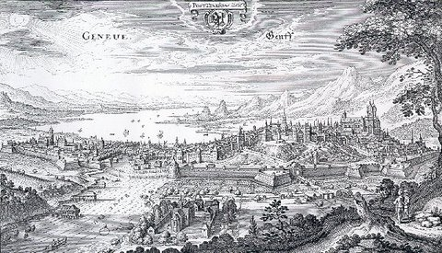
Geneva

Slide 9
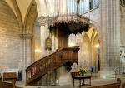
Geneva: Church, pulpit, school

Slide 10
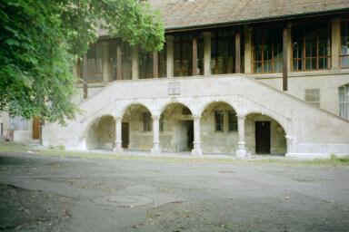

Slide 11
Starting: God is in control of everything
what JC comes back he says: the Church cannot survive unless a government is constituted as prescribed to us by the word of god and as observed in the early church” -- this was agreed to which mean that his acceptance of the pastorate also reformed the government
Hence government is not just repression (p 46)
There is positive content (not just restraint (p 46)
- and earlier “The enacting of laws that require a man to live among his fellows purely, honorably, modestly
Calvin tries to
reconcile authority and community by placing all authority in God’s hand only
make people think of community as common state under God
give people a standard of judging human affairs which is not based on external authority -- internalize the standard
theology is the important contribution
do b by escaping from
authority in the past (12)
custom (reified) (16)
liberation from a defining law *Christian liberty)
Only God decides (27)
volition allows escape from fear (imp psych point (29-30)
choice, personal decision thus essential (31)
should not slide off into hierarchical (10-11)
Consequence: saints saw in themselves what they condemn in others
paradoxical democracy (he who is without sin cast the first stone)
no one can claim the last word
we should do the right because it is right not because of reward
Predestination

Slide 12
WHAT POLITICS
assurance which allowed them to repudiate the old order
discipline
sense that the non-saintly world is a nasty place -- community. Bound together by
covenant
voluntary choice and training
no tenure -- trials
equality (no real status (clothes and sumptuary laws)
politics are programmatic
politics are systematic
possibility of experiment (starting over)
develop a sense that political knowledge is possible - magistrature should be obeyed from conscience not fear; loyalty to office and not person
“I will not cease from mortal fight
Nor shall my sword sleep in my hand
Till we have built Jerusalem
In England’s green and pleasant land”
problem of too much vigilance, too many meetings (as Oscar Wilde said about socialism)

