Slide 1
Charles-Louis de Secondat, baron de La Brède et de Montesquieu
1689-1755

Slide 2
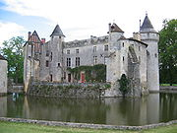
Chateau de la Brede, Southwest France

Slide 3
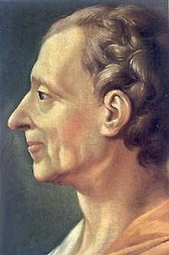
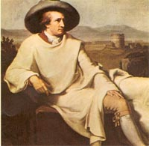
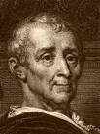

Slide 4
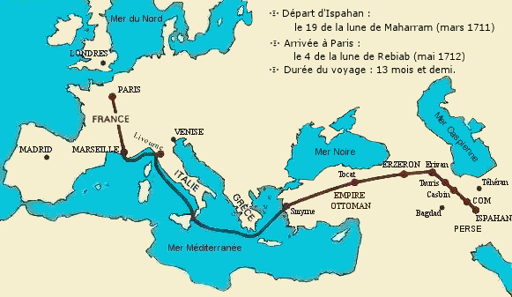

Slide 5
Main Players
Usbek – Persian nobleman
Chief black eunuch – in charge of harem during Usbek's absence
Rica – Usbek’s travel companion
Zachi, Zephis, Fatima, Roxanna, Zelis - wives of Usbek

Slide 6
Montesquieu: Biography
Style and genre of the PL
Relation of Spirit of the Laws and PL
Despotism
Law
Turkish model
Worst is to live in fear

Slide 7
Persian Letters
Two themes:
How people deceive themselves
arbitrariness of power is visible only to those on whom it is inflicted
Why a novel of letters about foreigners?
Usbek
Religious man seeking enlightenment
Lack of true conversation

Slide 8
Questions of PL
What is happiness and why is it rare?
Who is happy?
Which human bonds work and which do not?
Ideal despotism and its fantasy
French institutions and their insanity
The meaning of tyranny

