Slide 1
Walter Benjamin
1892-1940

Slide 2
BENJAMIN
- 1940
cognoscenti reputation in left-wing circles in Germany
trying to escape -- Pyrenees blocked that particular day - suicide
Brecht: the first real loss to literature caused by Hitler
book collector
collector of quotations
wanted to write a book made up only of quotations
Beckett

Slide 3
Important Works
Zur Kritik der Gewalt (Critique of Violence / 1921).
Goethes Wahlverwandtschaften (Goethe's Elective Affinities / 1922).
Ursprung des Deutschen Trauerspiels (Origin of German Tragic Drama [Mourning Play] / 1928).
Einbahnstraße (One Way Street / 1928).
Das Kunstwerk im Zeitalter Seiner Technischen Reproduzierbarkeit (The Work of Art in the Age of Mechanical Reproduction / 1936).
Berliner Kindheit um 1900 (Berlin Childhood around 1900 / 1950, published posthumously).
Über den Begriff der Geschichte (On the Concept of History / Theses on the Philosophy of History) / 1939, published posthumously).
Das Paris des Second Empire bei Baudelaire (The Paris of the Second Empire in Baudelaire / 1938). (“Arcades Project”)

Slide 4
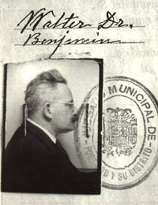

Slide 5
Work of Art in the Age of Mechanical Reproduction
I. Marx :infrastructure and super structure
note that Marx thought that the tendencies of exploitation would put an end to capitalism
importance of the idea of production and reproduction
WB argues that superstructure change takes place more slowly than in infrastructure
his question: how has changed production of art changed the significance of art in or lives
this is what he calls the politics of art

Slide 6
PART II:
art can always be reproduced (copies and so forth)
but with lithography we have something where the art exists ONLY as a copy
why should this be important? - speed;: with film it can keep pace with speech: change . Two matters of importance: reproduction of works of art (posters); and film

Slide 7
Part III
original work of art has a unique existence: “presence in time and space”
includes changes; ownership
the concept of authenticity : “the essence that is transmittable from its beginning, running from its duration to the history it has experienced”
authenticity gives us a notion of history: when it is challenged, then the sense if history and time is challenged.
two forms of reproduction: manual and mechanical
against the manual the original preserves its authenticity
less so against the mechanical
here the process does not depend on the original
and: the copy can move into venues which are new: can “meet the beholder.” 220
what do we loose when art is mechanically reproduced: its ”aura”
art detached from tradition
many copies give it a plural rather than singular existence
shattering of tradition
linked by WB with contemporary mass movements
FILM liquidates the past: cites Abel Gance: http://www.youtube.com/watch?v=3dzlP5pfXK4

Slide 8
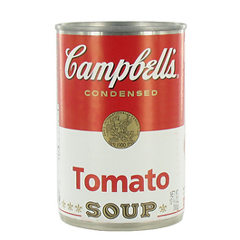
Aura?
by Andy Warhol – silkscreen and hand; sold for $11.7M in 2006
Poster of painting by AW –sells for $5
Campbell Tomato Soup Can –sells for $1.35

Slide 9
PART IV:
sense perception change over time
sense perception is learned and taught
the contemporary change is the decay of the aura
desire of the masses to get closer, to ”get ahold of an object a very close range
this requires the “Armed eye” -- i.e. transitorines and reproducibility
universal equality of things -- everything is like everything else
corresponds to statistics
PART V:
idea of a tradition: changeable but a guarantee of uniqueness
has its basis in ritual -- in doing something, in a kind of use
with mechanical reproduction, art responds by developing the idea of art for art
what do we make of this change
mechanical reproduction emancipates art from its parasitic dependence on ritual
we move from art reproduced to art made for reproduction
footnote: film and the need for amass audience (the “gross”) -- advent of sound film at first reinforces national boundaries but also reinfuses capital into the film making process
So what does art come to be based on: WB says politics (no ritual)

Slide 10
PART VI:
distinguish art for cult
stone paintings /church sculptures today
and art for exhibit
has to be moveable -- not fixed in place (religious statue vs bust): compare mass to symphony
PART VII:
exhibition value displaces cult value (but not without a fight)
What do you carry in your wallet: in photography the resistance comes in the use of photos as remembrance devices
use of photo as historical evidence (hidden politics)
use of the caption
picture magazines

Slide 11
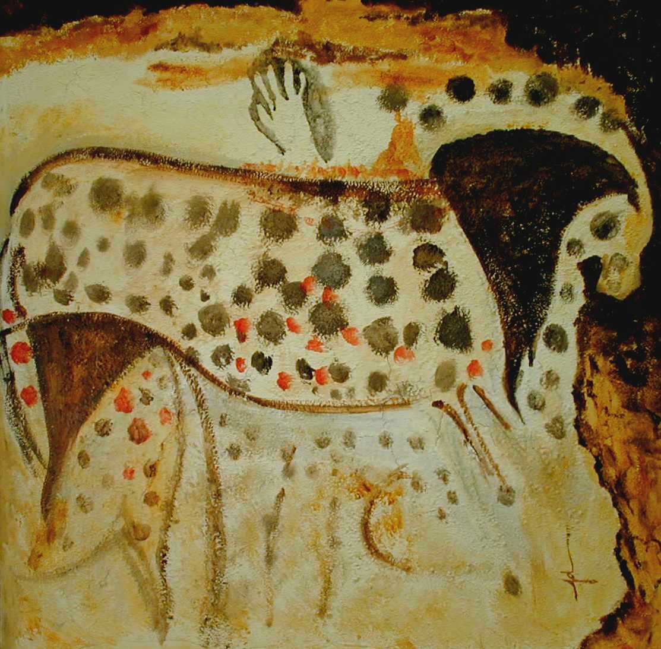
Spotted Horse, Pechemerle Caves, France

Slide 12
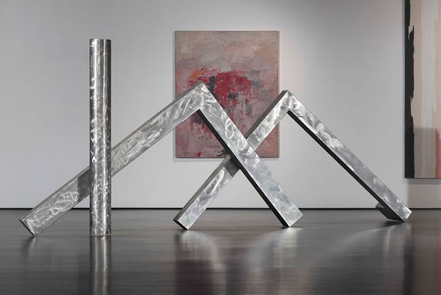
David Smith, Cubi XXIII (1964) Los Angeles CMA

Slide 13
`Osios Loukas, Greece

Slide 14
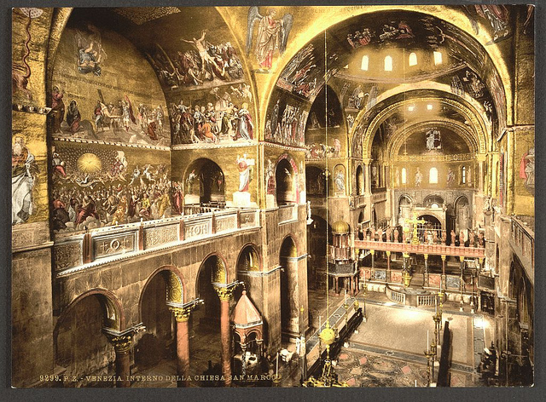
Saint Mark’s, Venice

Slide 15
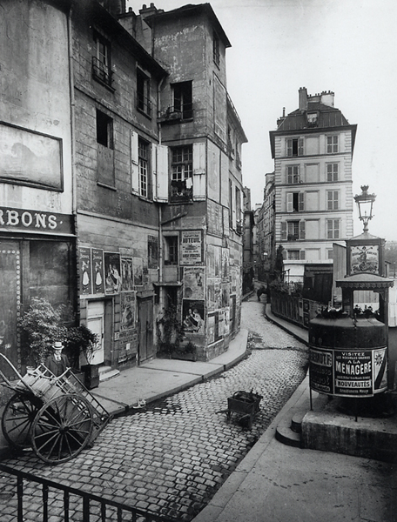
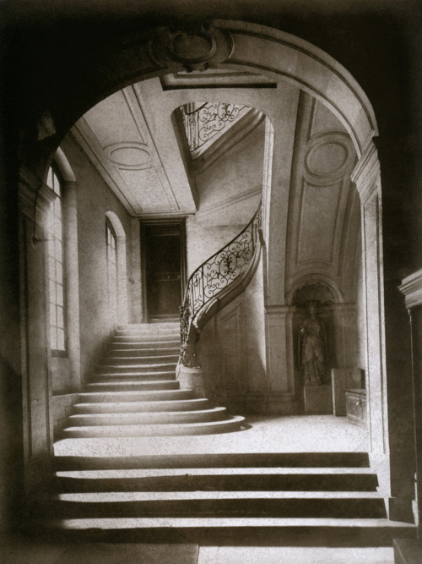
Eugene Atget (VII)

Slide 16
Mona Lisa – Paris - Louvre

Slide 17
PART VIII:
the development of photography and film:
question is not is it art, but how has it changed what art is
tendency to want to talk about film as if it were ritual
PART IX:
the audience relationship to a film:
film actor’s performance is constituted by the film
cannot be adjusted to the audience
there is no contact of the audience with the player
audience has position of camera
audience is in the position of TESTING the film:
not a cultic situation

Slide 18
PART X:
the film actor represents himself to the camera, rather than representing something else.
The whole living person but without the aura: on stage the aura emanates from the actor; on film the camera substitutes for the public. HENCE no aura
relation of actor to part is very different
art is no longer semblance
Part XI--XIII:
the labor of the actor is beyond the reach of the actor
studios respond to the shriveling of the aura with cult of the film star
this is the way in which the film industry resists the revolutionary potential of film (except as a critique of traditional art)
everyone who goes to a film is an expert.
Anyone can get on film
distinction of author and public begins to fade
this becomes Warhol’s famous for 15 minutes

Slide 19
PART XIV
there is no place from which the studio is not the place of illusory (compared to an audience position in theater)
painter is a magician -- maintains distance between himself and reality; cameraman is a surgeon: cuts into reality and reassembles fragments by a new law
and this gives a reality which is free from all equipment
PART XV
we get in film the possibility of both a critical and receptively enjoyment attitude
experts but not at a distance
argument that Euripides should have been on film
this explains reactionary reactions to modern art: museums are a sign of crisis in art: it is a hierarchical, domineering mediation ()
PART XVI
there is a medium and also a use of the medium
compares to our sense now of Freudian slips
film gives us the possibility of analyzing things which would not have previously been available
close ups, hidden details
enlargement reveals new things
WB calls this “unconscious optics” –CHAPLIN and the ”eccentric”
http://www.youtube.com/watch?v=xoKbDNY0Zwg

Slide 20
Chaplin, The Gold Rush
http://www.youtube.com/watch?v=xoKbDNY0Zwg

Slide 21
Chaplin - Modern Times
http://www.youtube.com/watch?v=wENE7O-Y6ME

Slide 22
PART XVII
art creates demands which can only be satisfied later.
Dadaism intended a relentless destruction of the aura of their creations
one cannot remain silent and contemplative before a Dada piece. In this it is like film:
Compare the attitude one has to a painting: invites contemplation
But with film -- no contemplation -- scene changes “My thoughts have been replaced by moving images”

Slide 23
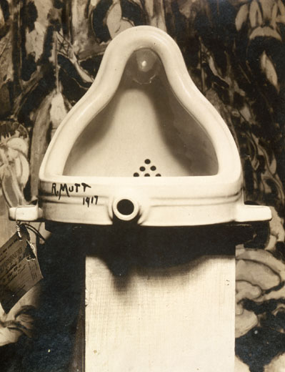
Marcel Duchamp - Fountain
Dadaism

Slide 24
Hannah Hoch (1919) Cut with the Dada Kitchen Knife through the Last Weimar Beer-Belly Cultural Epoch in Germany

Slide 25
How to make a Dada poem – by Tristan Tzara
Take a newspaper.
Take some scissors.
Choose from this paper an article of the length you want to make your poem.
Cut out the article.
Next carefully cut out each of the words that make up this article and put them all in a bag. Shake gently.
Next take out each cutting one after the other.
Copy conscientiously in the order in which they left the bag.
The poem will resemble you.
And there you are — an infinitely original author of charming sensibility even though unappreciated by the vulgar herd.

Slide 26
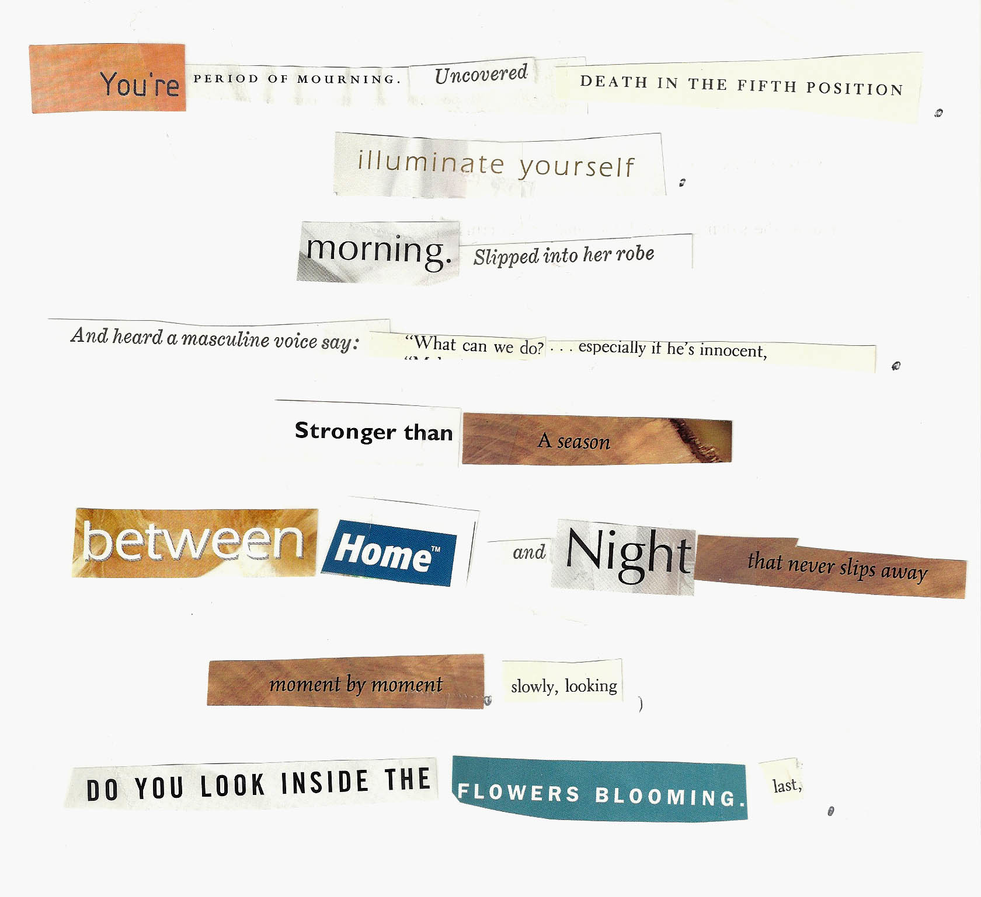

Slide 27
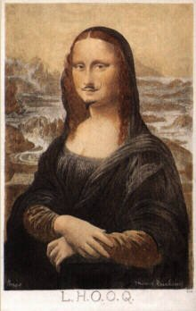
Marcel Duchamp, L.H.O.O.Q., 1919, rectified readymade, pencil on a reproduction
Hans Arp, Collage with Squares Arranged According to the Laws of Chance (1916)

Slide 28
“It is impossible to take time for concentration or evaluation…”(119): compare:
Rilke – Das Einhorn (The Unicorn) in Sonnets to Orpheus, II-4
August Stramm
O this is the beast who does not exist.
They didn't know that, and in any case
--with its stance, its arched neck and easy grace,
the light of its limpid gaze --they could not resist
but loved it though, indeed, it was not. Yet since
they always gave it room, the pure beast persisted.
And in that loving space, clear and unfenced,
reared it's head freely and hardly needed
to exist. They fed it not with grain nor chaff
but fortified and nourished it solely with
the notion that it might yet come to pass,
so that, at length, it grew a single shaft
upon it's brow and to a virgin came
and dwelled in her and in her silvered glass.
[Und die gab solche Stärke an das Tier,
daβ es aus sich ein Stirnhorn trieb. Ein Horn.
Zu einer Jungfrau kam es weiβ herbei – und war im Silber-Spiegel und in ihr.]
Battlefield
Yielding clod lulls iron off to sleep
bloods clot the patches where they oozed
rusts crumble
fleshes slime
sucking lusts around decay.
Murder on murder blinks
in childish eyes.

Slide 29
PART XVIII
film is appropriated by its audience, in the way that architecture is; mastered not by contemplation but by appropriation
this is in response to the “film produces distraction” attack: the film goer is an absent minded critic.
EPILOGUE --XIX
fascism IS AN ATTEMPT TO GIVE THE MASSES THE CHANCE TO EXPRESS THEMSELVES (WITHOUT CHANGING PROPERTY RELATIONS)
introduction of aesthetics into politics
produce ritual values
necessarily requires war --

Slide 30
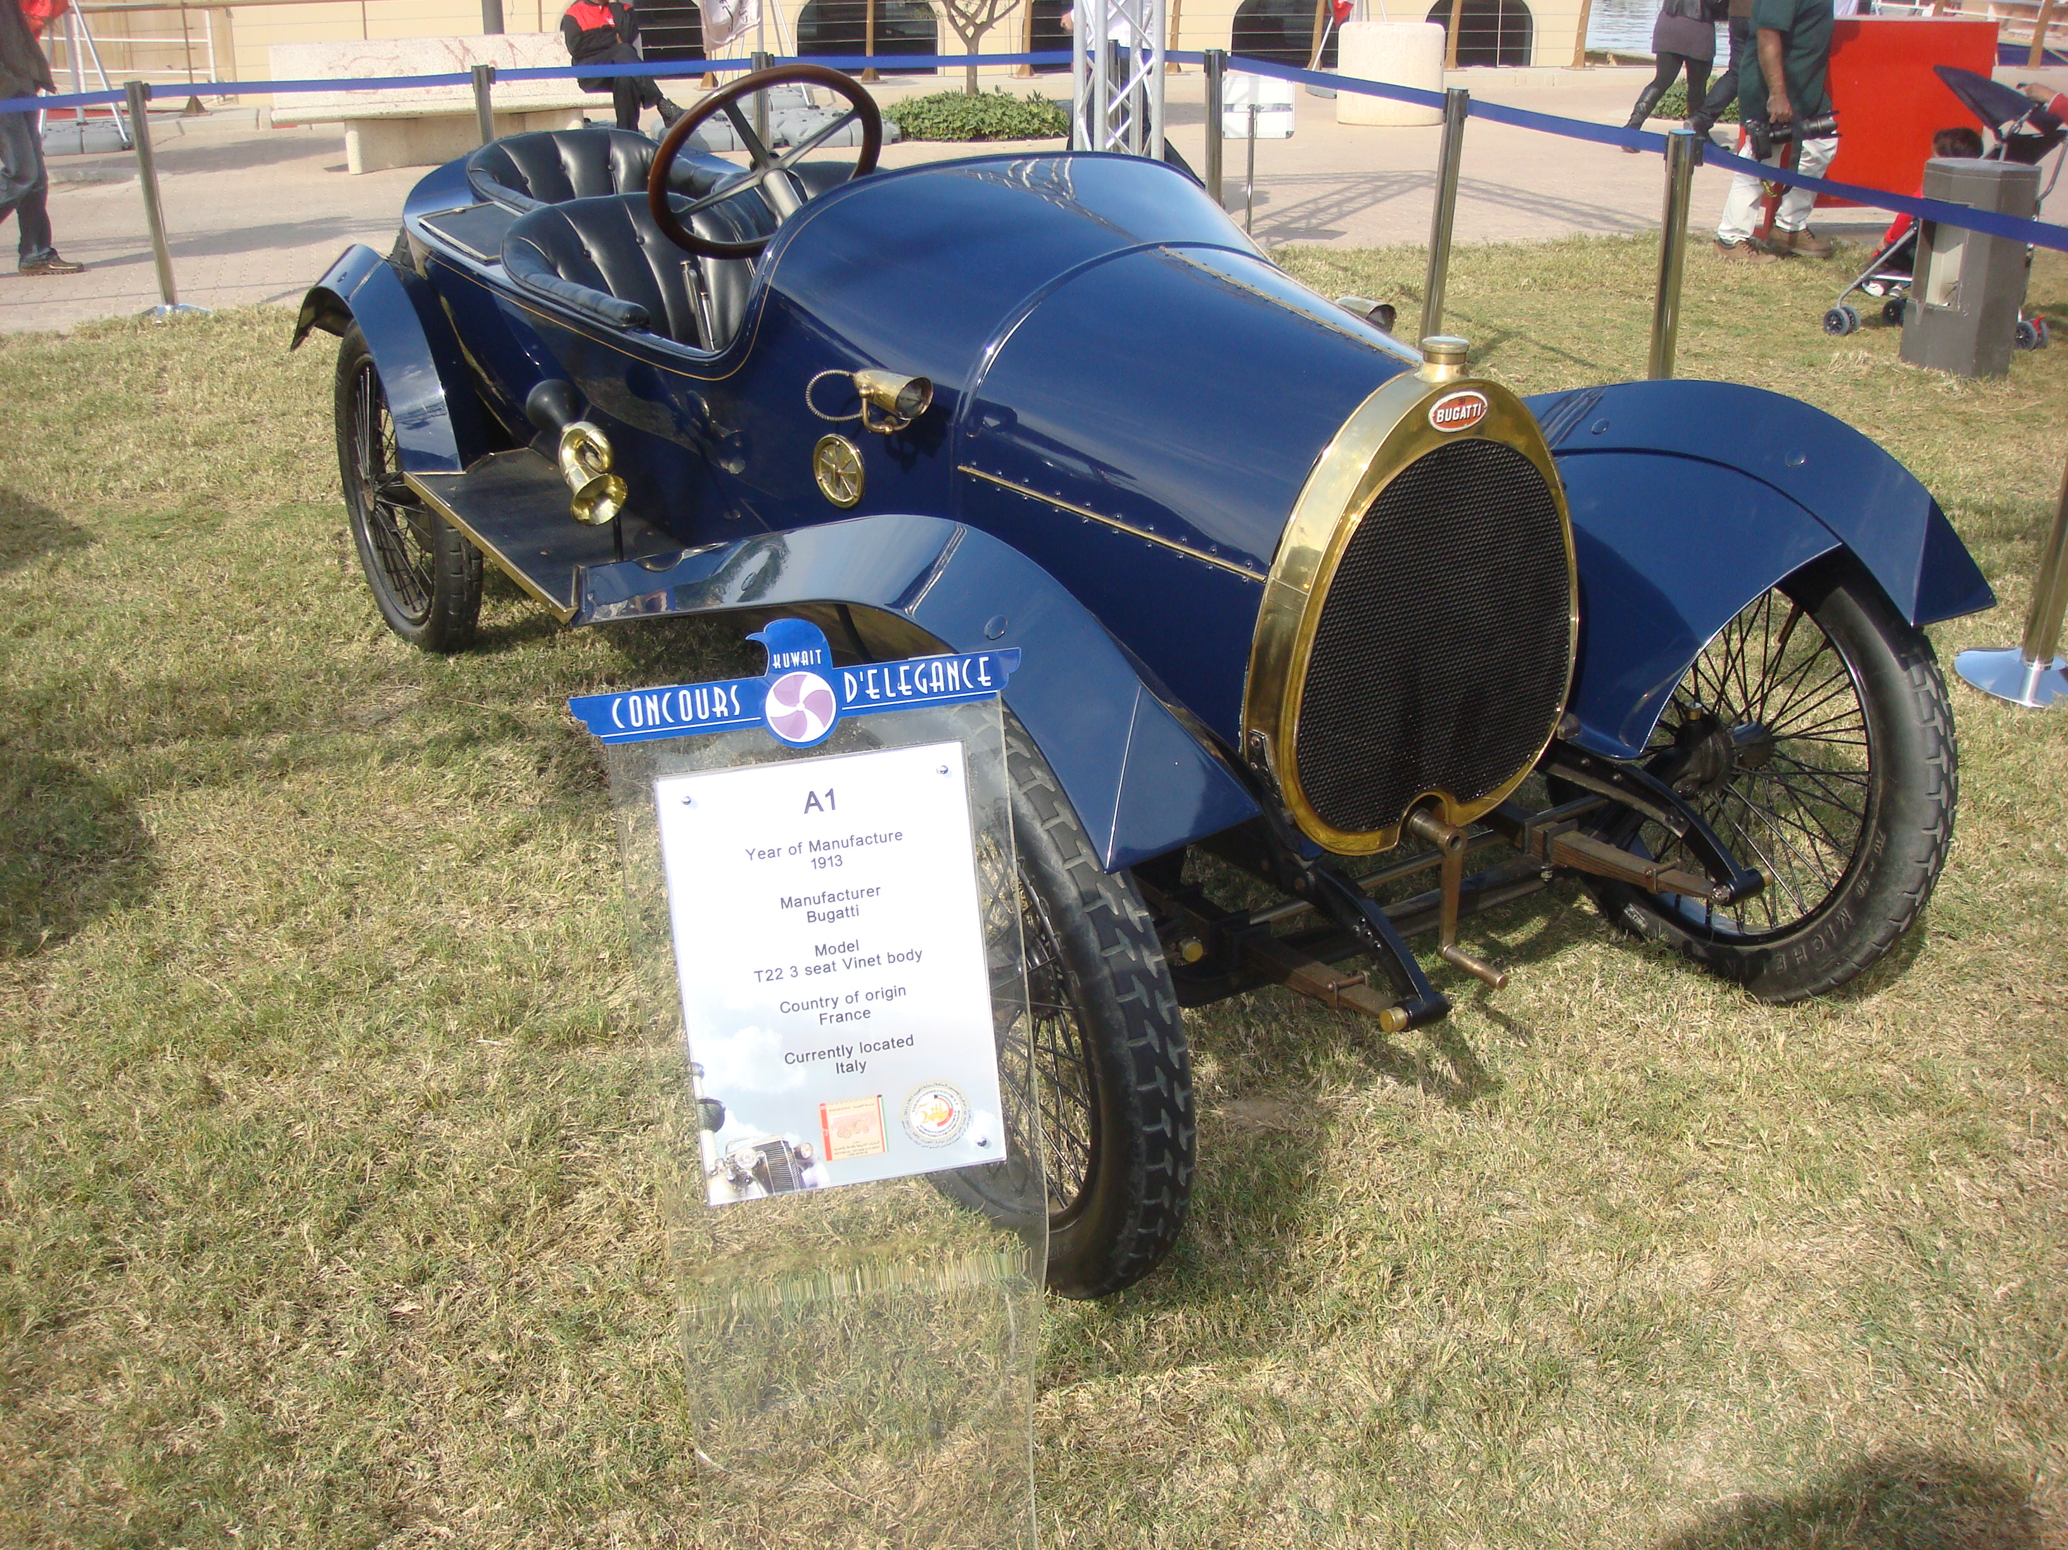
Boccioni – Unique Forms of Continuity in Space

Slide 31
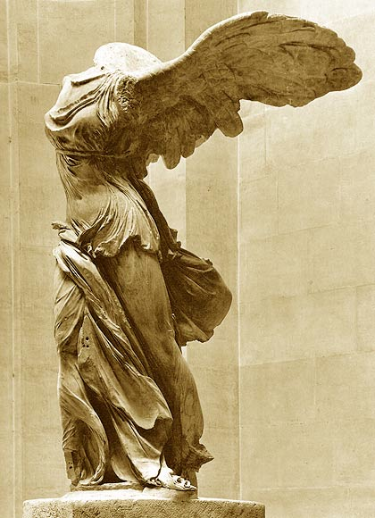
"We declare that the splendor of the world has been enriched by a new beauty: the beauty of speed. A racing automobile with its bonnet adorned with great tubes like serpents with explosive breath ... a roaring motor car which seems to run on machine-gun fire, is more beautiful than the Victory of Samothrace.” (Marinetti)

Slide 32
The Uses of/for Film
Opening of Triumph of the Will
http://www.youtube.com/watch?v=BrGHFvqkcKg

