Slide 1
Man’s Fate – La condition humaine
André Malraux

Slide 2
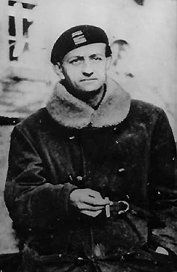
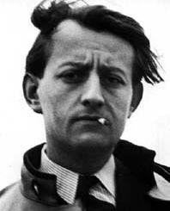
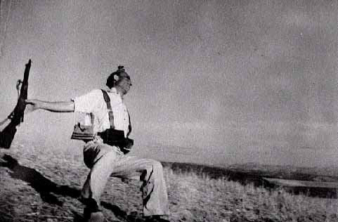
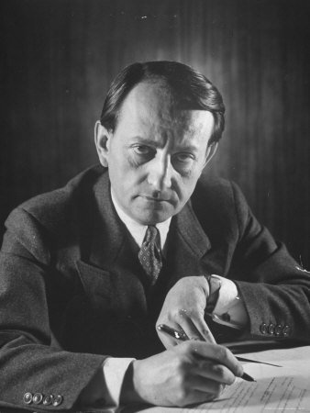
Malraux: 1901-1976
Resistance , France, 1941-
Spain, 1936
Minister of
Culture,
1959-
Photo by Robert Capa

Slide 3
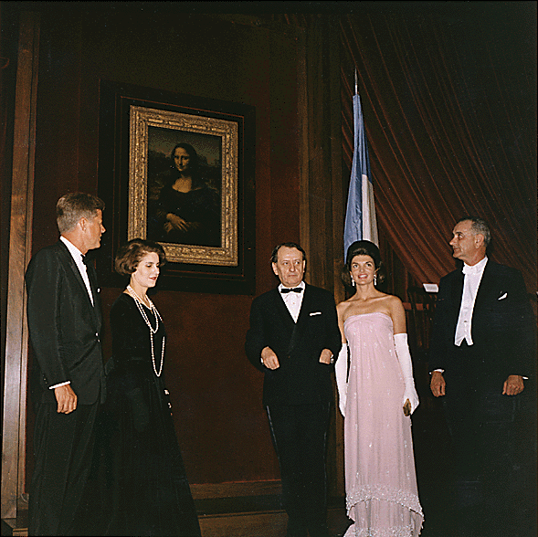

Slide 4
"Man is dead, after God". Malraux, The Temptation of the West. (1926)
‘The artist is not the transcriber of the world, he is its rival.’
Malraux, L'Intemporel (3rd volume of The Metamorphosis of the Gods.)
'In a world in which everything is subject to the passing of time, art alone is both subject to time and yet victorious over it'. Malraux in a television program about art, 1975.
"Art is an object lesson for the gods." The Voices of Silence
“The art museum is one of the places that give us the highest idea of man." The Voices of Silence
"Humanism does not consist in saying: ‘No animal could have done what I have done,’ but in declaring: ‘We have refused what the beast within us willed to do, and we seek to reclaim man wherever we find that which crushes him.’" The Voices of Silence
"The greatest mystery is not that we have been flung at random between this profusion of matter and the stars, but that within this prison we can draw from ourselves images powerful enough to deny our nothingness." Les Noyers de l'Altenburg

Slide 5
Antimemoirs: an episode
AM is on a mission to China from DeGaulle (French President). Stops in Saigon during the Vietnam War; is met by Clappique (character from Man’s Fate) who shows him a movie script he has written about a chap Perken, whom Malraux had placed in his first novel as a hero- figure but is now seen by Clappique as a vain liar. C remarks he had sent some stamps to AM (which he says to C he received). C ends the movie script narration with “Well, what do you think?” Next line is “The next day I saw the grey of the American destroyers in Danang.”

Slide 6
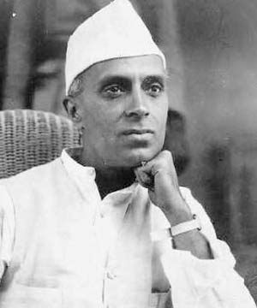
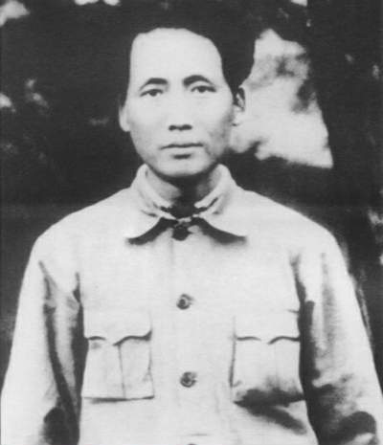
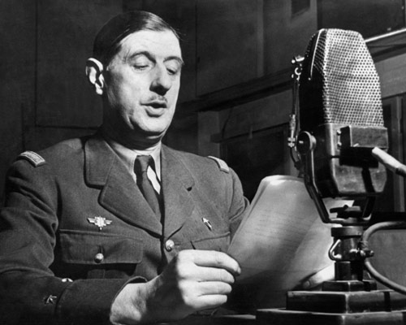
Antimemoirs gives
Three men who rise above history: The creation and enacting of a State.

Slide 7
General question of MF
What is the possibility of real self-knowledge and its relation to political action?
“Dare to lead the tragic life and you will be redeemed…” – Nietzsche, BT

Slide 8
cast
Ch'en Ta Erh – the assassin. Protagonist.
Kyo Gisors – the leader of the revolt. Protagonist.
Baron De Clappique – a French merchant, smuggler, and obsessive gambler. Protagonist.
Old Gisors – Kyo's father, one-time Professor of Sociology at the University of Peking, and an opium addict, acts as a guide for Kyo and Ch’en
May Gisors – Kyo's wife and a German doctor, born in Shanghai
Katow – A Russian, one of the organizers of the insurrection, he is burned alive for treason.
Hemmelrich – A Belgian phonograph-dealer.
Yu Hsuan – His partner.
Kama – A Japanese painter, Old Gisors' brother-in-law.
Ferral – President of the French Chamber of Commerce and head of the France-Asiatic Consortium. He struggles with his relationship with Valerie because he only wishes to possess her as an object.
Valerie – Ferral's girlfriend.
Koenig – Chief of Chiang Kaishek's Police.
Suan – Young Chinese terrorist who helped Ch’en, later arrested in the same attack in which Ch'en was killed.
Pei – Also helped Ch’en.

Slide 9
Scene I: preparing the insurrection (March 32)
Assassination: Begins with confrontation with death
Phonograph
Kyo meets Clappique
Katov and troops
Kyo with his father
May and Kyo (she is a doctor)
Old Gisors and Chen
Kyo and Katov at the river

Slide 10
Scene II
11 AM: Ferral at a strike
Ch’en and police station
Ferral and insurrection triumph
PM: Ferral and Valerie
Kyo and Ch’en

Slide 11
Scene III: Hankow (center of CP strength)
Kyo and Vologin and Ch’en
CP and KMT relations

Slide 12
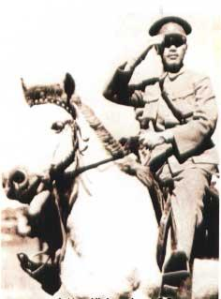
Scene IV
Clappique and Count Shipilevski
Ch’en and Smithson (missionary) and bombing
Clappique sees Kyo; finds Kama with Gisors
D. Katov at Himmelreich’s
Ferral: Chiang will turn on CCP

Slide 13
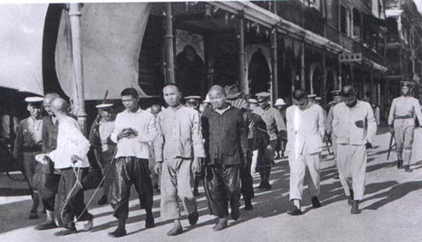
Scene V
Chiang about to move on CCP
Kyo gets that news/ arrested
Himmelreich and family
Old Gisors and Clappique

Slide 14
Scene VI
Kyo in jail
Clappique and Ferral leave
Brotherhood of the revolution
Locomotive scene
Gisors and May

Slide 15
Scene VII
Ferral in Paris
Kobe
“I hardly ever weep any more.”
What is the role of Part VII?

