Slide 1
GROUP 6 - Tribal Issues From the Perspective of Sovereignty
DEMI, HALEY, JOE, KELSEY, CLAIRE

Slide 2
Question: What roles has the United States government played through its Indian policy to foster tribal sovereignty rights guaranteed to Native Americans through treaties? In what ways has it hindered the exercise of these rights in various aspects of tribal affairs, specifically in the areas of spirituality, land, women, and the environment?
Research method:
Desire Based

Slide 3
Native Americans' Spirituality Infused into all Aspects of Life
Land
  Religious ceremonies helped bring everything into balance
  Resource - people have an obligation to protect it
Inland Whale - This story of the woman, her bastard son, and the whale is almost the perfect example of the relationship between a tribe and nature, the individual and nature, and the spirituality that ties them together

Slide 4
Native Americans' Spirituality Infused into all Aspects of Life
Allotment
  White men and the Native Americans look at land in completely different ways
Environment
  Preserve the land to pass it on to future generations
Religious renewal
  A yearning for the past to guide the future

Slide 5
The Return of Land to Native Americans
U.S. Government has traditionally given monetary compensation to tribes
Blue Lake & 48,000 acres returned to Taos Pueblo (1970)
  Critical to tribal religion and culture
  One of the first instances of land being returned based on a religious argument

Slide 6
Government Inconsistencies
Forest Service challenged by Northern California tribes
  Road plans would hinder ability to practice religion
Supreme Court case Lyng v. NW Indian Cemetery Protective Association (1988)
  Contradicted Blue Lake reasoning
  Based on 1st Amendment rights

Slide 7
Land Recovery: Fee-to-Trust
Originally enacted by Indian Reorganization Act (1934)
Opposition from state/local governments
  Loss of tax revenue
  Ways used to regain revenue
  Tribes forced to double tax members

Slide 8
Federal Government Support
Claims Resolution Act (2010)
  $1.9 billion land buyback program
  Enables tribes to buy previously allotted land
Government has started to recognize Indian land rights
  Lacks full understanding of the relationship between land and religion

Slide 9
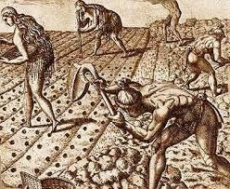
Native American Women's Roles From Colonial to the Present

Slide 10

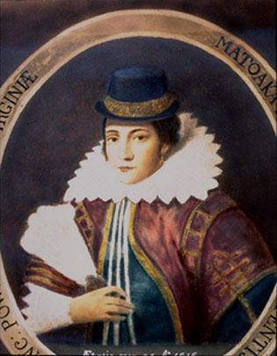
Pocahontas
Settler Colonialism
  Assimilation into European culture.
Native Women Political Roles
  Mediators
Relationship to Land
  The "givers" and "sustainers" of life.
    A spiritual connection to land.

Slide 11
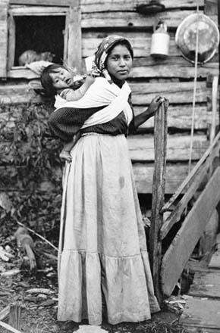
Cherokee Women
Treaty Making
  The treaty of Hopewell 1785
Matrilineal and Matrilocal
  Women's position in the household.
Civil Programs
  Assimilation
Relation to the Dawes Act...

Slide 12

Termination
Gender Roles
Women's place
Disconnecting the Body From Land.
Effect: both spiritually and physically
  Pocahontas
Settler Colonialism
Creation of space

Slide 13
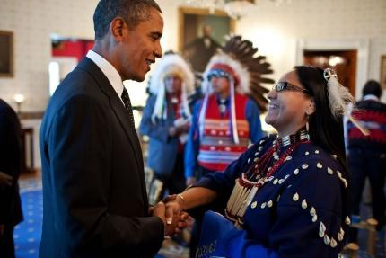
Modern Day
Activism
  Environmental issues
Women in government: Locally
  Juana Majel Dixon
  La Vonne Peck
What really has changed for Native women?

Slide 14
Indian Women's Safety: Legal effects of government policies and their interference with sovereignty
The problem:
The safety of Native American women is always being compromised
Targeted victims of sexual and physical assault

Slide 15
Statistics to illustrate
Indian women 2 ½ times more likely to be assaulted
And more than twice as likely to be stalked than other ethnicities
1/3 Indian women will be raped
6/10 will be physically assaulted
Murder rate for Indian women on reservations 10 times national average
Clearly, we have a problem

Slide 16
Role of Government Policy
Government policies have almost always impacted the issue
They dictate the restrictions and punishment systems that deal with crimes
Two main policies: Public Law 280 and VAWA

Slide 17
Public Law 280
1953
Tribal courts should manage reservation crime
But only when involving Indians
State police not allowed to persecute non-Indians for crimes on reservations
Only the FBI can
The FBI don’t care
Loophole that predators are aware of and abuse

Slide 18
VAWA
Violence Against Women Act - 1994
Recently reauthorized for the third time
Republican obstructions
Newest revision: tribal courts can prosecute non-Indians
Conditions: e.g. tribes must have functioning jailhouses
Other improvements
“Additional tools for protecting [Indian women] by authorizing warrantless arrest authority for federal officers…”
Legal relief for victims of immigrant status

Slide 19
Tribal Environmental Perspectives
Environmental justice from a Native American perspective = desire-based
EPA’s definition lacks:
  Structural causes of environmental injustice
  Considerations of sovereignty

Slide 20
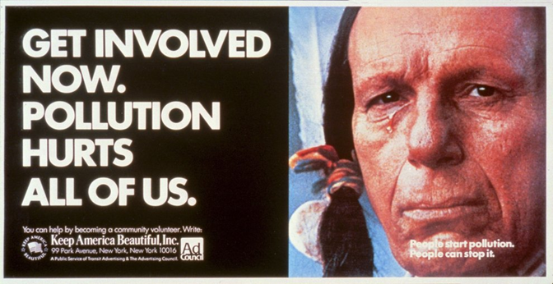
Structural Inequalities
The power to define
“Environmental Indian”

Slide 21
Sovereignty
The authority to decide what one desires for one’s future and recognize that vision
Impacted by environmental injustice & other structural problems
Need for reform

Slide 22
Conclusion
We have discussed different areas of Indian affairs which are interconnected with one another and to Indian sovereignty more broadly.
Native peoples desire sovereignty and the ability to use it to reach other desires.
Through our research we hope to have shown the significance of sovereignty to the futurity of Native cultures and their desires.
Native Americans are advocating for the recognition of their sovereignty in U.S. governmental policies as well.

Slide 23
Contribution
We hope to have provided an understanding of these issues through the lens of sovereignty while also conveying the importance of sovereignty itself to the futures that Native Americans desire.

