Slide 1
U.S.-LATIN AMERICAN RELATIONS
Political Science 146A
SPRING 2016
Peter H. Smith

Slide 2
CONTACT INFO
phsmith@ucsd.edu
Social Science Building 364
Wednesday 2-4
Kathryn Baragwanath
kbaragwa@ucsd.edu
John Gotti
jgottiucsd@gmail.com

Slide 3
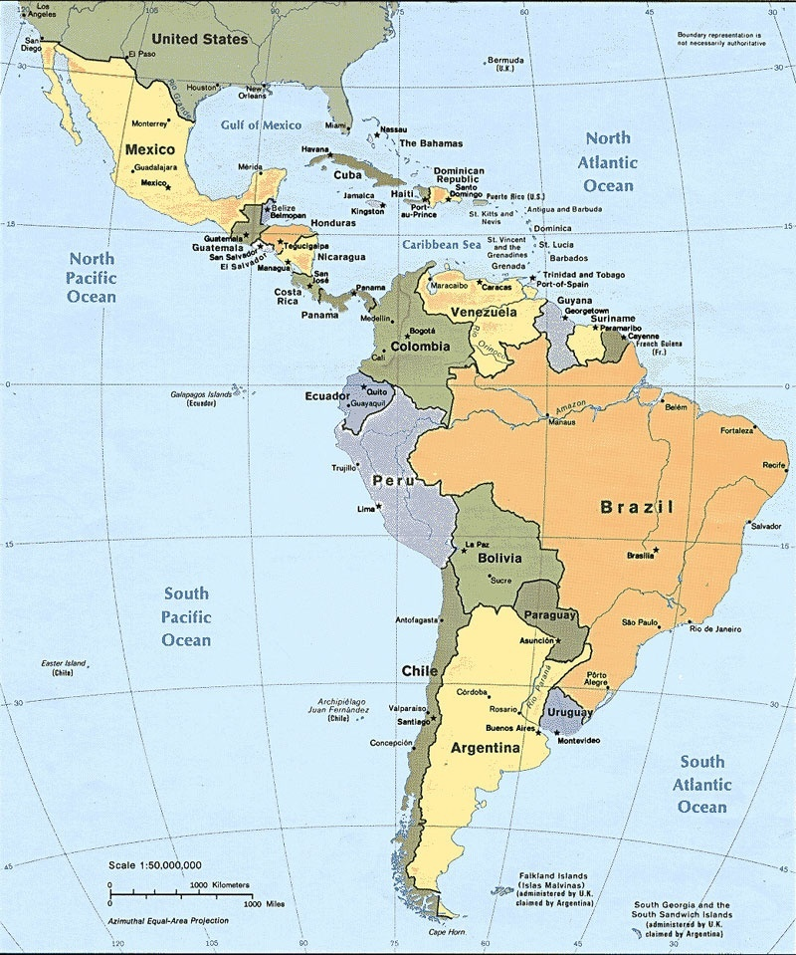

Slide 4
Key Questions
What is the current state of U.S. relations with Latin America?
What (if anything) is unique or “new” about the present situation? How much have we seen before?
Where is the relationship headed? What might the future hold?
Subtext: strong vs. weak, disparity in power

Slide 5
Key Questions
What is the current state of U.S. relations with Latin America?
What (if anything) is unique or “new” about the present situation? How much have we seen before?
Where is the relationship headed? What might the future hold?
Subtext: strong vs. weak, disparity in power

Slide 6
Course Design
Course Structure and Conceptual Approaches
Historical Stages
1. Imperialism in the Americas
2. Cold War in the Americas
3. The 1990s: From Geopolitics to Geoeconomics

Slide 7
The Contemporary Scene: 9/11-present
The War on Terror and Global Realities
Neglect and Opportunity for Latin America
The Political Economy of Drug Trafficking
Migration and Latino Communities
Barack Obama and the Politics of Hope (?) Conclusion and Review

Slide 8
The Contemporary Scene: 9/11-present
The War on Terror: Geopolitics and Global Realities
A New World, the New Left
The Political Economy of Drug Trafficking
Migration and Latino Communities
What’s Up with Cuba?
Barack Obama and the U.S. Campaign
Conclusion and Review

Slide 9
Analytical Tools
Nation-state as unit of analysis (not markets, not psychology)
International systems with distinct “rules of the game”
Formulation of “grand strategies” (depending on perceptions of world arena)
Disparities in power
“Hard” vs. “soft” power

Slide 10
POINTS OF ENTRY
Readings:
Smith, Talons of the Eagle, 4th edition (2013)
Holden and Zolov, Latin America and the United States: A Documentary History 2nd edition (2011)
Videos:
“Missing”
“South of the Border”
“Maria Full of Grace”
“The 800 Mile Wall”
“Latin American and Caribbean Presence in the U.S.”
Guest speakers:
Susan Rice
Barack Obama

Slide 11
ASSIGNMENTS AND DATES
May 04: “mock” midterm
May 25: closed-book exam (33% course grade)
June 01: 10-15 page paper (67% course grade)
NB: There will be no final exam!

Slide 12
A CAST OF CHARACTERS

Slide 22
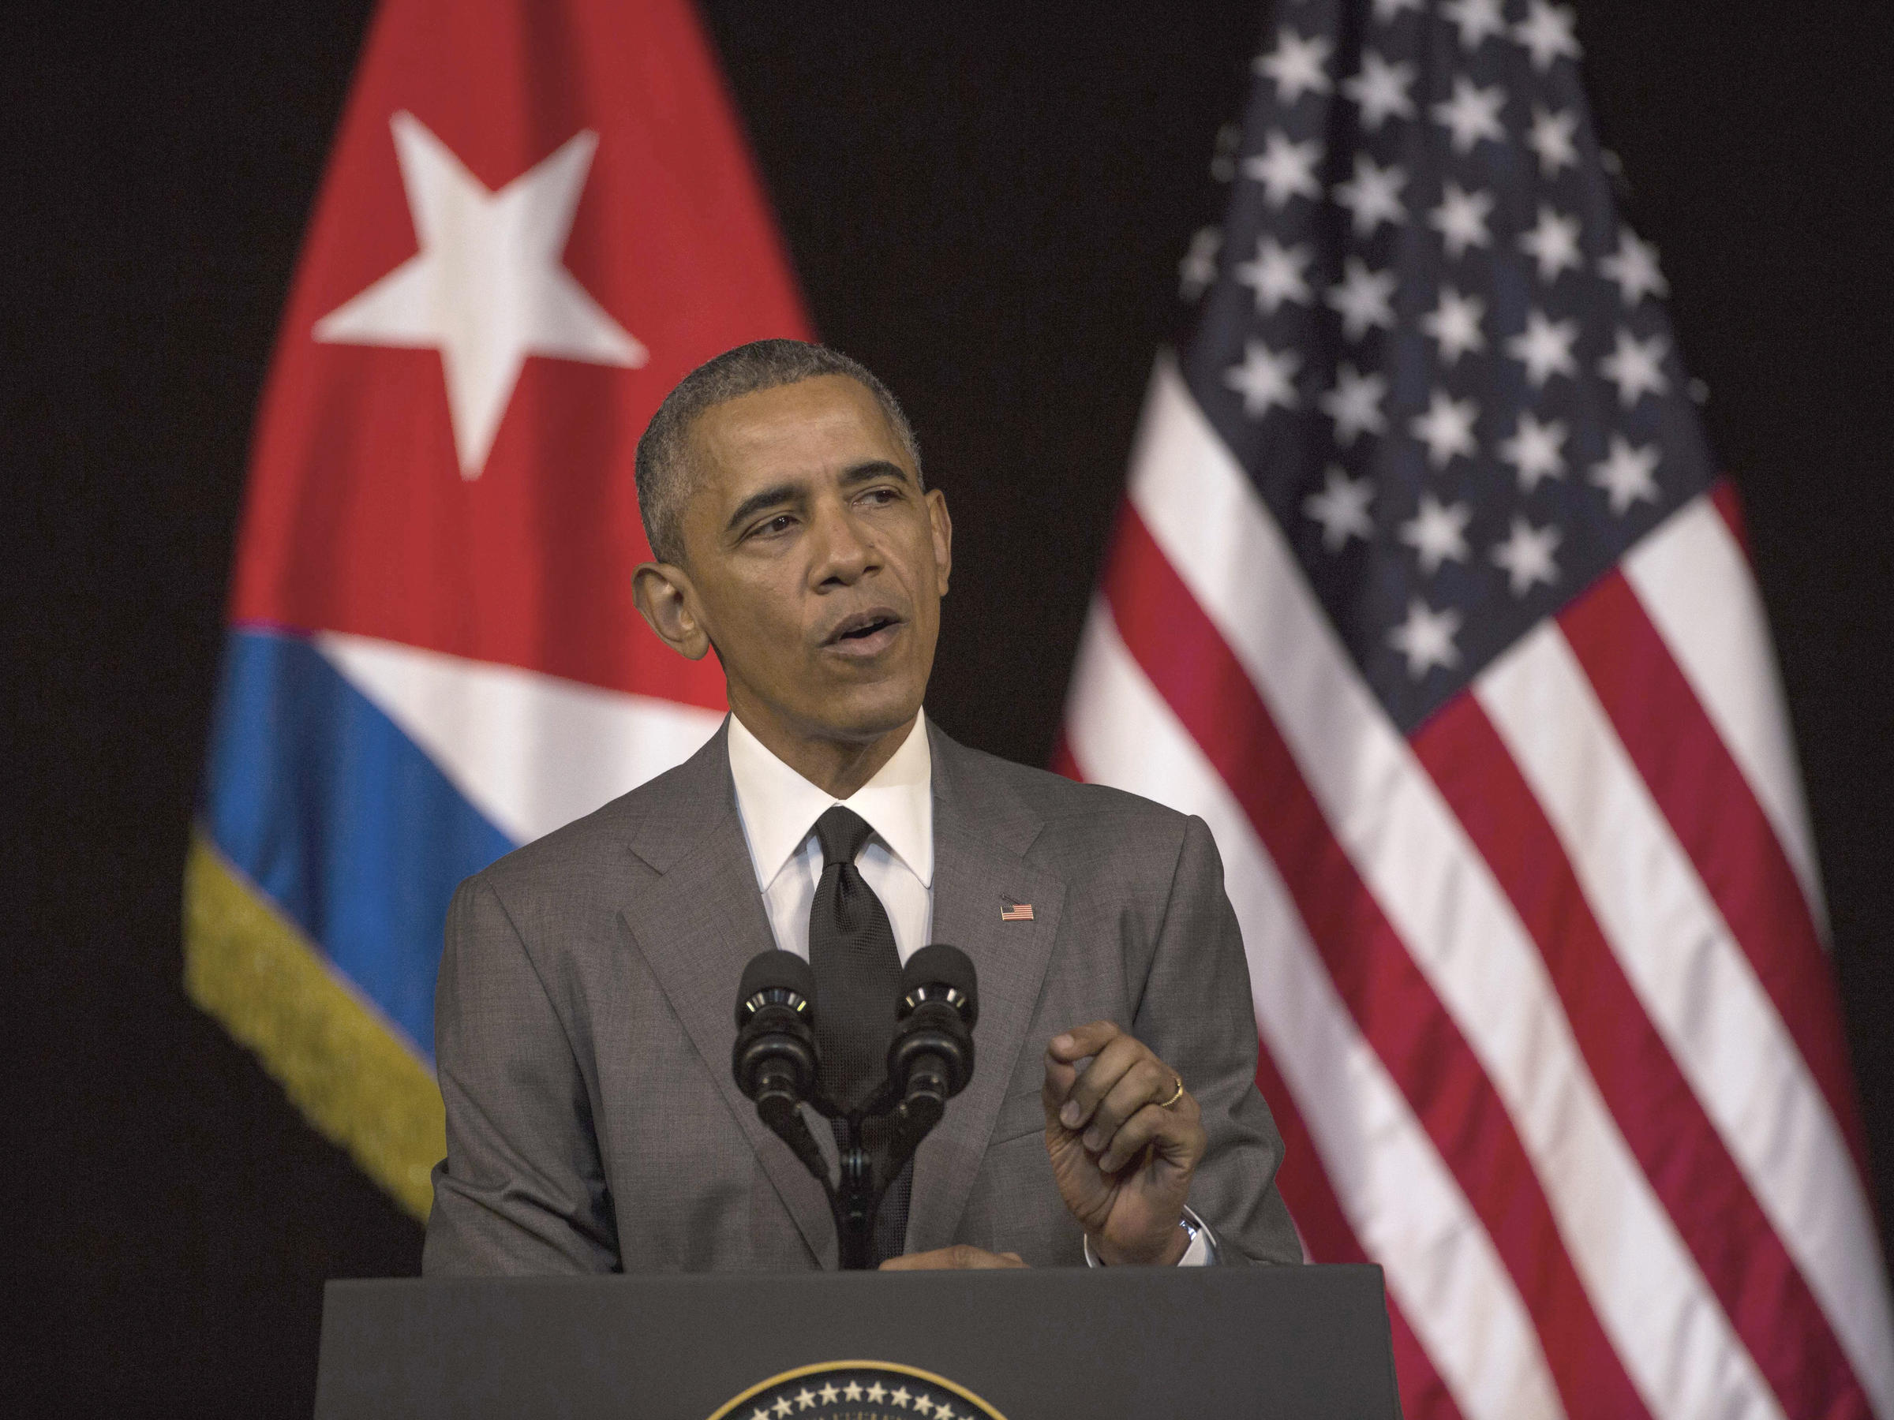

Slide 23
PARTING THOUGHTS
Have fun in this course!
Q: If ignorance is bliss, knowledge must be…. ?

