Slide 1
A DEATH FORETOLD: MOTIFS AND ALLUSIONS
LATI 50
Introduction to Latin America

Slide 2
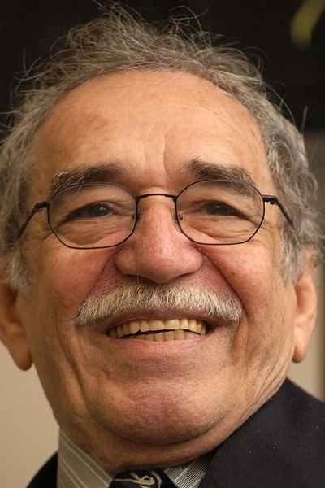
Gabriel García Márquez, 1927-2014

Slide 3
“MAGICAL REALISM”
Controversial term
Imagination>objectivity as path to human truth
Sublime>mundane, absurd>logical
Juxtaposition: massive scale in tiny places
Straightforward narration of preposterous people and events

Slide 4
CHRONICLE: STORY LINE
Stranger (Bayardo San Román) comes to town looking for a bride, settles on Angela Vicario
Discovers on wedding night that she is not a virgin, thus provoking crisis of honor
She names Santiago Nasar as “the perpetrator”
Her brothers set out to murder Santiago as a matter of honor
Ceremonial arrival of bishop that same morning
The whole town knows of brothers’ intentions—and no one does anything to stop them. Warning message unseen.
Questions: Why? How? Who bears responsibility?

Slide 5
CHARACTERS (I)
Santiago Nasar
Plácida Linero (his mother)
Ibraham Nasar (father)
María Alejandrina Cervantes (madam)
Victoria Guzmán (cook)
Divina Flor (Victoria’s daughter)
Clotilde Armenta (storekeeper)
Flora Miguel (Santiago’s fiancée)

Slide 6
CHARACTERS (II)
Angela Vicario (bride)
Pedro and Pablo Vicario (brothers)
Purísima del Carmen [de Vicario] (mother)
Poncio Vicario (father)
Margot (narrator’s sister/nun)
Luisa Santiaga (narrator’s mother)
Prudencia Cotes (Pablo’s fiancée)
Father Carmen Amador (priest)
Cristo/Cristóbal Bedoya (friend)
Bayardo San Román (suitor/husband)
General Petronio San Román (father)

Slide 7
ON LOVE
“the pursuit of love is like falconry”
“A falcon who chases a warlike crane can only hope for a life of pain.”
(Note: Santiago Nasar practiced falconry)
“Love can be learned too.”

Slide 8
ON GENDER AND SEX
“It’s time for you to be tamed.” (Santiago to Divina Flor)
“Any man will be happy with them because they’ve been raised to suffer.” (Angela + sisters)
“The only thing I prayed to God for was the courage to kill myself. But he didn’t give it to me.” (Angela)

Slide 9
ON RELIGION
Pomp and ceremony: “It’s like the movies.” (Santiago)
“For the love of God… Leave him for later, if only out of respect for his grace the bishop.” (Clotilde)

Slide 10
ON HONOR
“I can imagine, my sons…. Honor doesn’t wait.” (Prudencia’s mother)
“We killed him openly, but we’re innocent. … Before God and before men, it was a matter of honor.” (Pedro and Pablo)
“I never would have married him if he hadn’t done what a man should do.” (Prudencia)
“affairs of honor are sacred monopolies, giving access only to those who are part of the drama.”

Slide 11
ON PREJUDICE
Santiago an “Arab,” prompting fears of retribution from Arab community
Pride in wealth “Just like all Turks.”
Angela disliked Bayardo thinking he was “a Jew”
Magistrate: “Give me a prejudice and I will move the world.”

Slide 12
REFLECTIONS
Code of honor unquestioned
Coincidence or inevitability: “”It’s as if it already had happened.” (Pablo to Pedro)
Guilt or innocence
Passivity, responsibility, and community

Slide 13
A POLITICAL PERSPECTIVE?
Book published in 1981
Brutal military regimes in Argentina, Brazil, Chile, and Central America
Archbishop Oscar Arnulfo Romero assassinated in El Salvador (March 1980)
Chronicle a parable about political violence… and allowing it to happen?

