Slide 1
LATI 50
Introduction to Latin America
WINTER 2016

Slide 2
Who Is This Guy?
Captivated by Latin America (and relationship with United States) as “accidental tourist” in Mexico
Historian by training, political scientist by self-education and ad hoc exposure
Faculty positions at Dartmouth College, University of Wisconsin, MIT; at UCSD for > 25 years
Extensive research on Argentina and Mexico
Research programs on Latin American relations with Europe and East Asia
Most relevant publications—Modern Latin America, 8th edition, and Talons of the Eagle: Latin America, the United States, and the World

Slide 3
PHS Coordinates
Office Hours: Wednesday 3:30-5:00, CILAS #3
E-mail: phsmith@ucsd.edu
Website (lectures will be posted):
http://pages.ucsd.edu/~phsmith/teaching.htm

Slide 4
TA and Sections
M.A. Program in Latin American Studies
Christopher Brennan (chbrenna@ucsd.edu)
Bianca Martínez (bnm005@ucsd.edu)
Wednesday 1:00-1:50, Center 207
Wednesday 2:00-2:50, Center 207
Office Hours: TBA

Slide 5
Why Latin America?
It’s big
It’s there
It’s here
It’s diverse
It’s a mirror
It’s a paradox
And in a globalizing world…

Slide 6
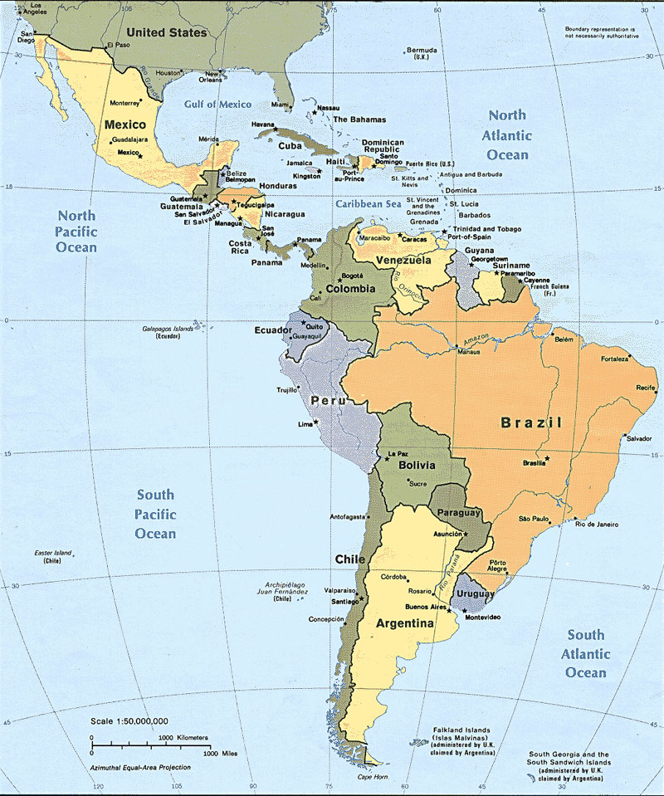

Slide 7
Elements of Paradox
Old-young, unstable-stable, rich-poor
Gender
Sports/Baseball
Religion
Politics
Literature

Slide 8
Points of Entry
Readings in Modern Latin America, 8th ed (2014)
Fiction: García Márquez
Videos
Original documents (MLA website)

Slide 9
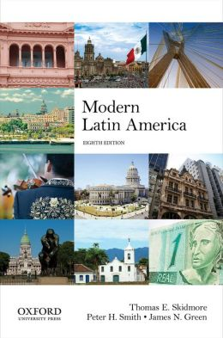

Slide 10
Course Organization
1: Introduction
2: Dimensions of History
3: Magical Realism
4: Economic Development
5: Democracy and Dictatorship
6: Social Inequality
7: Arts and Society
8: Popular Culture
9: Inter-American Agenda

Slide 11
Examinations/Papers
Mid-term exam (February 18) ~ 33% grade
Final exam (March 15, 11:30-2:29) ~ 67% of grade
Optional paper (March 9): 30% grade, so mid-term = 20% and final = 50%

Slide 12
PRINCIPLES OF GRADING
Reasonable command of factual material
Rigor of analysis
Clarity of expression
Hint: Answer the questions!
Class participation: as observed; attendance at sections obligatory
No pre-established curve
Typical distribution: 35 % As, 50% Bs, 15% <B
Procedure for appeals

Slide 13
¡Adelante!

