Slide 1
RACE, CLASS, AND SOCIAL STRUCTURE (part 2)
LATI 50
Introduction to Latin America

Slide 2
CLASS STRUCTURE
Upper Class:
Urban (industrialists, bankers)
Rural (landowners)
Middle Class:
Urban (merchants, lawyers, etc.)
Rural (small farmers)
Popular/Lower Class:
Urban (workers)
Rural (peasants, campesinos)
National Institutions:
State (including military)
Church
External Sector:
Economic (investors, merchants)
Political (foreign governments)

Slide 3
SHADINGS BY RACE
Race as a social construct
Indigenous peoples: exploitation and discrimination
African-origin peoples and slavery
Myths of miscegenation:
Mestizaje
Mulattos and Brazilian “escape hatch”

Slide 4
THE DOMINICAN REPUBLIC
Shares island of Hispaniola with Haiti
A “plantation society” (sugar and slaves)
1916-24 U.S. military occupation
1930-61 Rafael Leónidas Trujillo in power
1965 U.S. military intervention
1966-78 Joaquín Balaguer in power
1978- electoral democracy

Slide 5
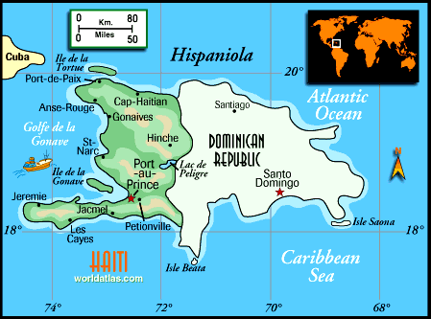
Hispaniola

Slide 6
THE QUESTION OF RACE
¾ population of mixed African-European descent
Cultural and social stratification: white > black
Antagonism with Haiti (occupation1822-44), uncertainty over identity
Trujillo cult of hispanidad, defining Dominicans as “the most Spanish people of America”
1992 celebration of “discovery and evangelization of America”
Reassessment of African legacy?

