Slide 1
The Interface Theory of Perception

Slide 2
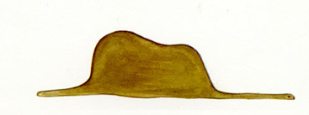
What do you see?
A hat?
An elephant?
A snake?
An elephant and a snake?

Slide 3
If you have seen this image before….
Notes:
If you have read Antoine de Saint-Exupéry's most famous novella “Adventures of the Little Prince” or you have seen this illustration elsewhere then I’m certain you were seeing an elephant swallowed by a snake in the first illustration. Otherwise it takes some effort to figure out what is going on here.

Slide 4
How about out in the World? In Real Life. What do we see? What is it that we perceive?
Notes:
In our psychology classes dealing with sensation and perceptions we experienced some illusions – optical and otherwise – that prompted me to ask “Are illusions just exceptions to the rule of the accuracy of our perception or are they pointing to the fact that our brain doesn’t really reconstruct the world as it is but more like gives us the necessary info to get by in our lives and can get tricked quite easily?
Donald D. Hoffman’s The Interface Theory of Perception tackles the idea of what is our perception? The answer he offers goes somewhat against most of our conventional thinking.

Slide 5
The Conventional view of perception
Notes:
The conventional view of perception supports that the main goal of our perception is to reconstruct the outside world for us

Slide 6
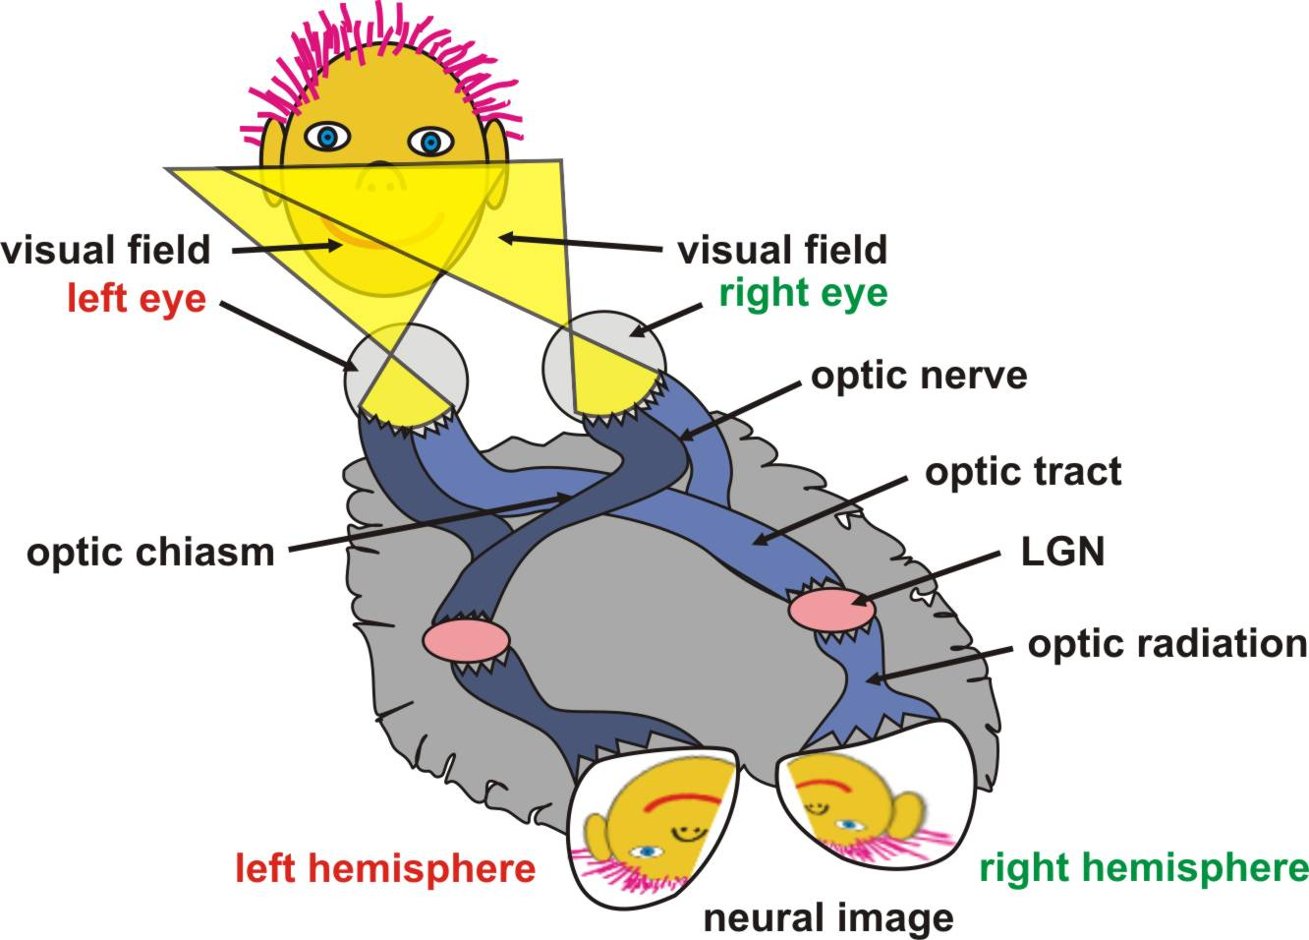
“A primary goal of perception is to recover, or estimate, objective properties of the physical world. A primary goal of perceptual categorization is to recover, or estimate, the objective statistical structure of the physical world.”
Notes:
The conventional view of many vision experts states that “A primary goal of perception is to recover, or estimate, objective properties of the physical world. A primary goal of perceptual categorization is to recover, or estimate, the objective statistical structure of the physical world.” This is the Principle of Faithful Depiction.
A good example of this view is the Bayesian approach to prove faithful depiction.

Slide 7
Bayes’ Theorem
Notes:
And how does our perception reconstruct the outside world for us?
I don’t want to get into too much detail of Bayesian Object Recognition. In short, the Bayes’ Theorem states that we can solve the problem of ambiguity of an observed image (posterior probability) combining the likelihood (conditional probability) with the prior probability of each object to make an informed guess regarding the image we are trying to interpret.

Slide 8
Which object is casting the shadow?
Notes:
A good example of this Bayesian interpretation is the problem of 3D objects which cannot be clear cut translated into a 2D retinal image without the help of some outside information. Such as this illustration, the 3 wire framed objects will cast the same exact shadow below. As a matter of fact an infinite number of objects can cast this same shadow you see below. Looking at this example we most likely will choose the bottom object as our best guess because that object has the largest posterior probability.
In other words, in our experience seeing a shadow such as the one in this illustration was most likely cast by a regular wire block or cube with rectangular sides.

Slide 9
Bayes’ Circle
“We can only see the world through our posteriors. When we measure priors and likelihoods in the world, our measurements are necessarily altered through our posteriors. Using our measurements of priors and likelihoods to justify our posteriors thus leads to a vicious circle.”
Notes:
Considering this theorem we are caught in a circular logic, Hoffman calls this, Bayes’ Circle “We can only see the world through our posteriors. When we measure priors and likelihoods in the world, our measurements are necessarily altered through our posteriors. Using our measurements of priors and likelihoods to justify our posteriors thus leads to a vicious circle.”

Slide 10
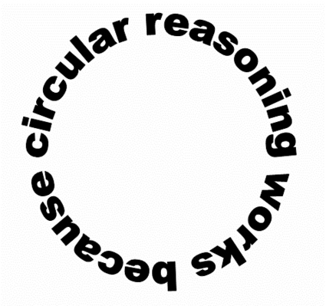
Bayes’ Circle
This essentially means that in order to know or perceive the world, we must have a prior knowledge or perception of it to compare to.

Slide 11
HMMMMMM
Notes:
Although the shadow in this illustration has the highest probability of being cast by the most bottom object Is it really? or our brain just gave us an answer based on our experience? Does our answer reflect what the object really is?

Slide 12
Maybe not a reconstruction
?
Notes:
Using the previous example we know the possible relations between our perceptual constructs and the objective world are infinite, identical reconstruction or isomorphism is just one of the possibilities.

Slide 13
Let’s examine a perceptual mistake
Notes:
An Australian jewel beetle seen on this picture considers desirable female to be shiny, dimpled with yellow brown wing casing.

Slide 14
Somewhere in Australia
Notes:
In line w/his life’s purpose he spends most of his time looking for the closest desirable female.

Slide 16
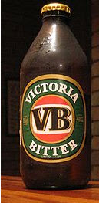
Shiny – check
Dimpled – check
Yellow brown –check
Desirable female ?
It must be …..
Oh no, not really
Notes:
Sadly what he is most likely to find these days meeting the
shiny, dimpled, yellow brown category is a beer bottle.
Apparently it’s easy to find an empty stubby beer bottle in the Australian bush maybe even easier than a desirable female jewel bug.

Slide 17
What’s wrong with this picture?
Notes:
Unfortunately for the jewel beetle besides a beer bottle not being a very fertile mate a species of ants had figured out the jewel beetle’s attraction to stubbies and the ants simply wait by the beer bottles and consume the beetles as they pursue their object of desire.
So what’s happening here? If perception was reconstructing the world, surely the size of the bottles would have set off an alarm somewhere.
Hoffman proposes the Interface Theory of Perception as an explanation why having shiny, brown, dimpled and VERY large would be enough for the jewel beetle to think he found a very-very desirable female. If the beetle’s perception is just a quick guide to life and not a duplicate of reality it makes sense that as long as the stimulus meets some basic criteria (brown, dimpled, shiny) it will think of nothing but romance. As a matter of fact, in this case of the beetle the SIZE of the bottle makes things worse. Size here is considered a supernormal stimulus – meaning it used to be even more desirable to find a really large female from the evolutionary perspective. Clearly, evolution wasn’t considering the beer bottles appearance. Supernormal stimulus makes those bottles completely irresistible for the beetles.
If our beetle was doing some sort of reconstruction he would have been alarmed by this giant “sexy-thing” rather than being attracted to it.

Slide 18
The Interface Theory of Perception
The perceptions of an organism are a user interface between that organism and the objective world
Notes:
Hoffman argues to take under consideration other possibilities that are compatible with evolution, so he proposes the Interface Theory of Perception: The perceptions of an organism are a user interface between that organism and the objective world.

Slide 19
An interface
Notes:
Just like your computer interface is between you and your computer. Hoffman is proposing that our perception is not accurate but it is very helpful for us navigating and surviving in the world just like our computer interface is very helpful in navigating our computer system. He proposes, the interface being species-specific since each species face different environmental challenges in the world.

Slide 20
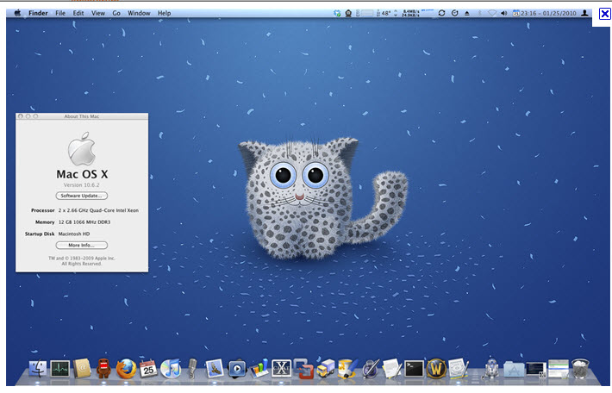
An interface
Notes:
Better yet for you Mac lovers an Interface
If perception is like a computer interface it gives living species an easy and relatively effective way to maneuver in the world. The interface does not have to resemble what it represents in order to be useful and if it does that is fine too.

Slide 21
Do I really want or need to know all this?
Notes:
Using the icons on our computer displays certainly make it easier to find a file and to organize our documents. Can you imagine if we had to somehow go through the hardware and point to the exact location of where the files were on our hard drive.

Slide 22
Where is my file????
An interface is helpful!

Slide 23
Conventional Theory
Reconstruction Thesis
“Perception reconstructs certain properties and categories of the objective world” (Hoffman).
In essence, what you see is what you literally get.
There are infinitely many and infinitely complex possibilities in the objective reality.

Slide 24
Interface Theory
Construction Thesis
“Perception constructs the properties and categories of an organism’s perceptual world” (Hoffman).
In a sense, we perceive only the necessary qualities of the objective reality.
Our perceptual systems instead display relevant representations of more complex phenomena in a simpler form, much like icons on a computer.

Slide 25
Interface Theory of Perception predicts that
Each species has its own interface
Almost surely, no interface performs reconstruction
Each interface is tailored to guide adaptive behavior in a relevant niche
Much of the competition between and within species exploits the strength and limitations of interfaces
Such competition can lead to arms races between interfaces and critically influence their adaptive evolution.
Notes:
The Interface Theory of Perception predicts that
- Each species has its own interface
- Almost surely, no interface performs reconstruction
- Each interface is tailored to guide adaptive behavior in a relevant niche
- Much of the competition between and within species exploits the strength and limitations of interfaces
Such competition can lead to arms races between interfaces and critically influence their adaptive evolution.
Unfortunately we don’t have time to go over each and every point Dr. Hoffman makes in his fascinating paper. I just hope you are now interested enough to read it and find out about this new and very cool way of interpreting preceptions.

Slide 26
Reconstruction? Model? Need for Isomorphism?
Perception is indeed qualitatively different from the represented physical reality: here Hoffman is right
Perception is not a reconstruction but it is a representation
Is Hoffman correct in maintaining that perception doesn’t even need an ‘isomorphism’ with reality?
2D retinotopic neural maps as an example of isomorphism
Given isomorphism, can we think of perception as a model of reality, hence constructed if not reconstructed?

Slide 27
References
D. Hoffman. The interface theory of perception: Natural selection drives true perception to swift extinction. In Object categorization: Computer and human vision perspectives, S. Dickinson, M. Tarr, A. Leonardis, B. Schiele (Eds.) Cambridge, UK: Cambridge University Press, 2009, 148–165.
J.P. Frisby and J.V. Stone Seeing The Computational Approach to Biological Vision, 2nd Edition, The MIT Press 2010

