Slide 1
Georg W. F. Hegel
1770-1831

Slide 2
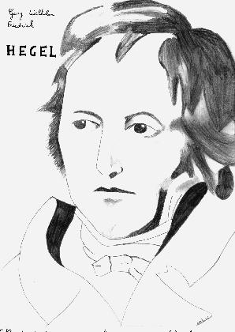
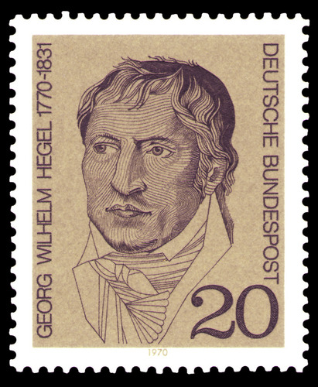
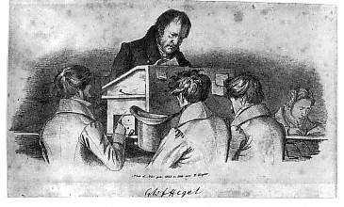
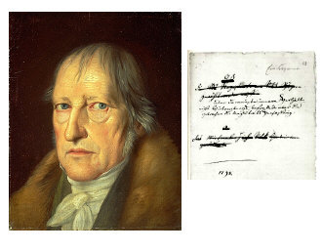

Slide 3
Short Biography
At 18 enters a Protestant Seminary
The French Revolution happens (1789) which he follows with enthusiasm
University appointments
Napoleon. At Jena: “I saw the Emperor – this world-soul – riding out of the city on reconnaissance. It is indeed a wonderful sensation to see such an individual, who, concentrated here at a single point, astride a horse, reaches out over the world and masters it . . . this extraordinary man, whom it is impossible not to admire.”
Eventually University of Berlin

Slide 4
What is Philosophy?
Philosophy “is its own time raised to the level of thought.”
Implies that the contents of philosophical knowledge changes with the times.
The “thought” grasps (thinks) its own time.
There is a dialectic between the world as we grasp it and the world as it is.
Leads to development.
Analogy to a child learning.

Slide 5
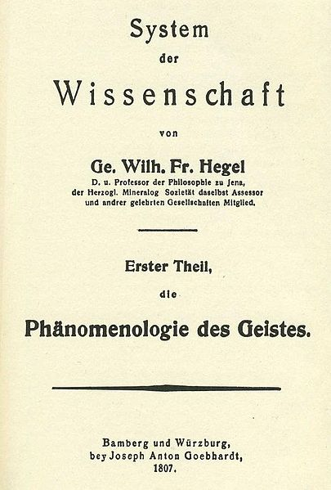
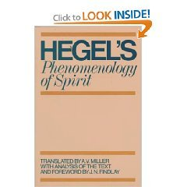
Phenomenology: “Science of the Experience of Consciousness” = science of how we come to grasp something and how that changes

Slide 6
Example: “Lordship and Bondsman” (from The Phenomenology of Mind)
Central idea: use the conflict or tension between what is and our idea of it as the dynamic force in history.
Pre-”Lordship and Bondage”: I have no consciousness of the reality of an other and seek to incorporate it into me. (Picture a young infant at the mother’s breast)
The other resists (Mother pulls away)
What does the infant do?

Slide 7
General pattern of development
The general pattern of development is as follows:
humans are in pursuit of self-knowledge – the fundamental question of history might be phrased as “who am I?”
we are conscious of who we are only to the degree that another recognizes us. Contrary then to liberal thinkers and to Kant (?) the self is understood as primarily social, or better, intersubjective. There is no self (in the end) without other.
We do not want to recognize others (even though their self-definition would require it
This leads to conflict. Should the conflict end with the death or disappearance of one of the involved entities, nothing will have been gained. If one entity in the conflict recognizes the other, with in turn being recognized, we then have a situation of inequality. Note that this is much like Rousseau, except that inequality here contains a dynamic element – thus the work is more historical than is R’s. Basic point: reality is social-political.

Slide 8
Lord and Bondsman
Lord/Bondsman is the paradigm example of the above process. It is not the only stage in this development but it is central.
The self-reality of the subject necessarily depends on recognition by others; we thus seek others; at first we try to incorporate the other into ourselves (think of a child who does not separate herself off from the world and hence has no self). But if we success in this the other is destroyed by becoming us. Hence what we need is another that will remain in existence, not be a stranger to us, and yet in whom we may find ourself recognized.
Should we attempt to know ourself without knowing another we will not be “certain of who we are” - -such “Self certainty has no truth”. To prove ourselves to ourselves we enter into a “life and death struggle. Note how this reinterprets Hobbes). We do this to show that the self is not identical to life itself (not attached to life” -, This is now a radical critique of Hobbes.

Slide 9
L & B, 2
IF death ensues then nothing is reserved and the self is not maintained. If one gives in, then both are preserved and we have a particular type of existence that Hegel call Lordship and Bondage.
If c/ happens the master has a self (for itself –) but his existence (Hers – women are an “irony in the life of the community” ) acquires its independence from the bondsmen acceptance of the far of externalities. The existence of the lord is problematic because
There is a third term to this process that Hegel calls thinghood. WE might think of this as nature-that-is-there-to-be-worked-on (Locke). The slave has direct contact with this, since it is what he transforms it he word that he does so that the master can live off of him. The master only has mediated contact with thinghood (through the bondsman).

Slide 10
L and B, 3
So in the end it is the servitude of the bondsman that is the most important factor here. Being mastered and in fear of violent death shakes the bondsman loose from the immediate. “The fear of violent death focuses the mind wonderfully on the universal.” This does not achieve anything by in self but when it is combined with the reality of labor:
Here we see that the master is like the Machiavellian Prince (I=I) for the master lives without resistance in the world since the bondsman labors for him. The bondsman however encounters resistance in the world since he works on it. He thus comes to see his own imprint on the world: he sees himself objectified, wanting to be recognized . The bondsman thus recognizes himself a a conceptualizing formative being in his power to make things (a power that he has only by virtue of his original bondsman status which was in turn due to his fear of the lord .
The slave is thus the victor, since he is shaping the world. The self that does this is still an abstract self, since it depends in part of its existence on the actuality of the lord. But it is progressive. Hence Hegel can see this self as progressing to other selves.

Slide 11
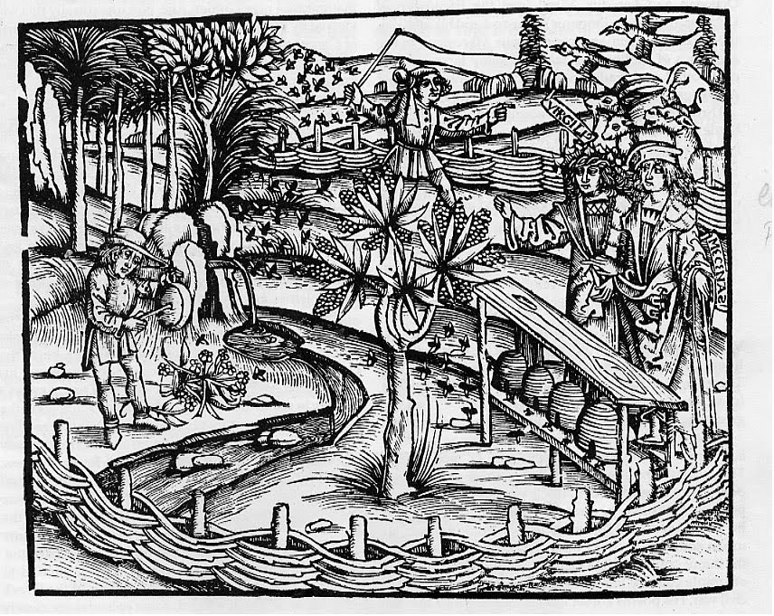

Slide 12
Phen. Of Mind II: “Absolute Freedom and Terror”
L and B can be read as critique of Hobbes’ analysis of state of nature; AF and T can be read as critique of Rousseau.
We have moved up in developmental time.
Stage starts with realization that there is nothing in the world that requires being treated with special reverence (because all has been made by human beings. This is the Enlightenment (and Rousseau)
The self is thought of as possessed with a rational will; hence it should be possible to make the world in the image of this will, to “bring heaven down to earth.” Thus the freedom to create is absolute. Individuals see themselves as creating the world and, as with Rousseau, they “cannot allow themselves to be represented.” Any structures in the world that interfere with this freedom must be destroyed.

Slide 13
AFT, 2
Therefore any institution that tends to particularize and make for less than universal moral rationality has to be eliminated. Government itself is seen as a “faction” ie in opposition to the universal. The only authentic action is revolution against that which denies universality. This is the terror.
This cannot be constructive; Hegel is pessimistic about the outcome of the French Revolution. It leads to “death and the fury of destruction.” Thishas only the significance of the “cleaving of a head of cabbage” or the ‘swallowing of a draught of water.”

Slide 14
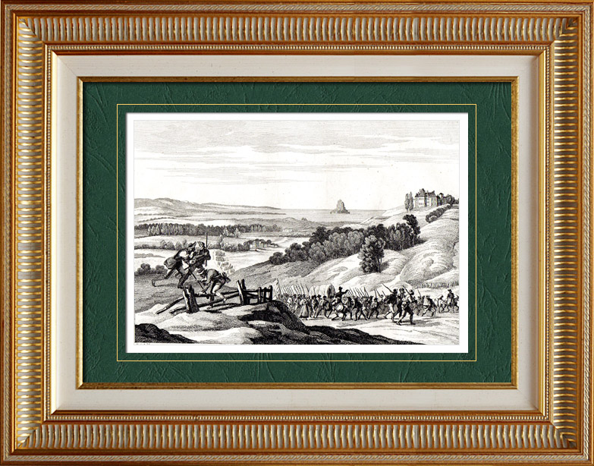
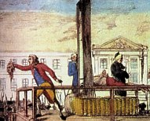
“Swallowing of a draught of water” – prisoners from the revolt in Western Central France (Vendee) were put on barges and these were then scuttled.
“cleaving of a head of cabbage”

Slide 15
AFT, 3
What is achieved. We see the exhasution of liberty conceived abstractly; freedom must be concrete, not an idea. Focus turns to institutions. The new cannot be built from the old, however. WE can build this new world
We are forced to understand tha the state does not depend solely on human will but is a vehicle of a higher trans-individual rationality. AFT sweeps away the past and prepares the way for a rational state in the future.

Slide 16
How to make historical sense of this: Introduction to the Philosophy of History
“One more word about giving instruction as to what the world ought to be. Philosophy in any case always comes on the scene too late to give it... When philosophy paints its gray in gray, then has a shape of life grown old. By philosophy's gray in gray it cannot be rejuvenated but only understood. The owl of Minerva spreads its wings only with the falling of the dusk.”– Hegel, Philosophy of Right

Slide 17
Terms
“Spirit” = Geist. (the term also means mind, wit, mentality, soul, intellect, ghost and even (alcoholic) spirits.
Think of uses like these:
“The spirit of freedom is spreading across the [pick your place].”
“Her spirit has grown and she has greatly matured.”
“He has a great spirit.”
“What is the national spirit of America.”
“In the beginning God created the heaven and the earth.
And the earth was without form, and void; and darkness was upon the face of the deep. And the Spirit of God moved upon the face of the waters.” Genesis I, 1,2

Slide 18
The Methods of history
I. Original history: actions that have been witnessed, in whose spirit the author shared.
A translation of outer into inner;
Immortality is achieved
Aim is individuality of a people
Scope is limited
In modern times the historians are not invovled but “intellectual” (5)

Slide 19
The Methods of history
II. Reflective: goes “beyond the present in spirit.”
Universal seeks to be an overview of a whole. The spirit of the historian is different from that of which he writes the history.
-Pragmatic: bring to present-day life that which is past. But we do not learn from history.
Critical: history of histories
Specialized: universal viewpoints (history of law, religion)

Slide 20
The Methods of history
III. Philosophic: application of philosophical thought to history. Problem; philosophy is about thought and history about facts –how do the two come together (10)

Slide 21
Section II:What then is the thought of philosophy?
“Reason” : Philosophy presumes rationality; does history?
Is there reason in history? (contra, say, Shakepeare: “a tale full of sound and fury signifying nothing”)
Clearly there is Reason in nature (planets) (14)
Religiously speaking there is reason in nature
Can we know the divine plan of Providence? (17)
We need a theodicy – a justification of the wasy of God/Reason

Slide 22
III/ Freedom, the Individual, and the State
What is the final goal of the world: content and actualization: the question of SPIRIT
Nature of Spirit: Matter is dependent; spirit if freedom (20)
Consciousness of freedom historically: aim is freedom
Means of Spirit: what is the meaning of the “slaughter-bench” of history (24)
Nothing great happens without passion (26) passion is what drives an individual towards the universal
What in a state is the relation of private interests and passions and the universal
The role of the antithesis (28)
Eg of building a house
“in world history the outcome of human actions is something other that that what the agents aim at and actually achieve…” (30)

Slide 23
III/ Freedom, the Individual, and the State, 2
The concept of world historical individuals (Caesar, Napoleon) (32-33)
The “Cunning of Reason” (35)
Query: the Middle East and Iraq invasion?
The concept of a “worthless existence” (39)
III. The State as Realization of Spirit; what is the goal?
Subjective will and rational will (negative and positive)
Together there is no antithesis between freedom and necessity (42)
Question : is society a limitation on our freedom?
Question: is this not like a family?
The state as freedom (49)
Various foolishness’s: art. Religion.
The state: summary (55)

Slide 24
IV/ History in its Development
Humanity has a chance for the better (57)
The idea of development
Think of child)
Stages of development and in the consciousness of freedom (60)
Contra: state of nature theories and Bible
To have history you must have stages and to have stages you must have a ‘subjective historical narrative” (65)
History is both universal and particular (67)
But it is not necessarily moral (71)
And it is European and nowhere else (cf 74)
Can this process come to an end (81)

Slide 25
V/ Geography (skip) and VI Division of History
1. Oriental World(93)
2. Greek World (adolescence)
3. Roman World (manhood)
Germanic world (old age= ripeness)

