Slide 1
David Hume
1711-1776

Slide 2
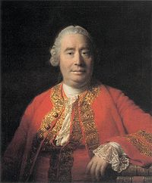
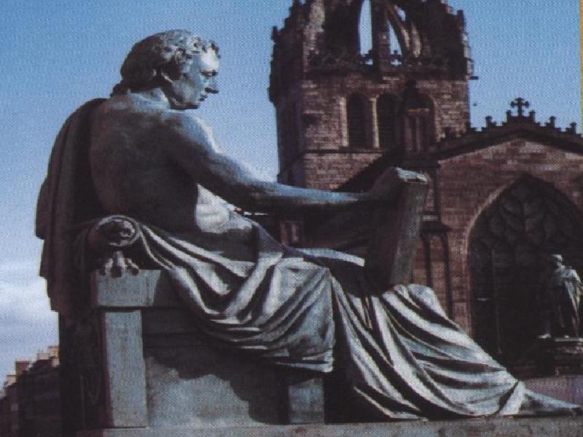

Slide 3
Hume
Mind is a bundle of impressions
Simple ideas
What is an idea?
True knowledge
Necessity
Getting beyond the immediate
Cause and effect
Necessity lies in humans

Slide 4
morality
Moral distinctions are not objects of understanding
Moral distinctions are not derived from reason
What is possible in these matters?
What idea of the persons corresponds to this?

Slide 5
Society and politics s
What founds it
Argument about the contract
Political consequences

