Slide 1
KARL HEINRICH MARX
1815-1883

Slide 2
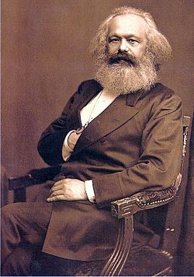
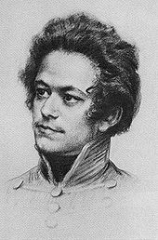
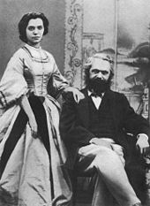
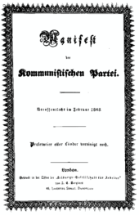
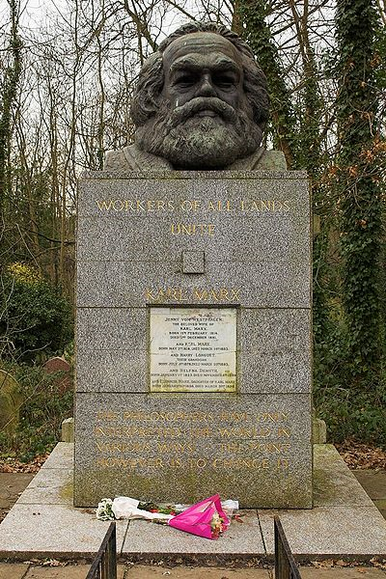
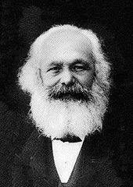
Marx in 1875 and 1882
Karl and Jenny Marx, 1866
Highgate Cemetery, London

Slide 3
Background
I. Biography
II. Historical and Conceptual
French Revolution
Rousseau
The rich and the poor
Hegel
Lordship and Bondsmen
III. Centrality of human activity

Slide 4
The oppositions in Marx
Though a student of Hegel, Marx thinks like a Kantian: viz these oppositions in CAPITAL
CONCRETE The PSEUDO-CONCRETE
Reality ideology
Essence phenomenon
Real world world of appearance
Laws external appearance
Real movement superficial movement
Internal kernel apparent existence
Concept representation
True consciousness false consciousness
Theory/science representation
WE LIVE IN THE RIGHT COLUMN AND NEED TO BRING ABOUT THE LEFT

Slide 5
What is the reality of the human situation?
A. humans produce the means of their subsistence.
B. under these conditions
Needs must befulfilled
Gives rise to new needs
Families
People are conscious of their situation

Slide 6
In what form do they produce?
Possible configurations
Tribal division of labor
Communal division of labor
Feudal division of labor
Towns
Country
Capitalist division of labor
Production of commodities
Divergence of individual and community interest leads to STATE

Slide 7
Capitalism
 |  |  | USE | VALUE
 |  | YES |  | NO
 |  | Exchange value | none | Exchange value | none
VALUE | labor | CORN: COMMODITY CAPITALISM | parenting | Classes | bullshit
SOURCE | other | honor | air | Gossip | God?

Slide 8
The mystery of capitalism
A.Value of labor power
B. how can wage-labor transaction be open and agreed to and STILL exploitative?
1. I sell my labor power for 8 hours at $6@hour = 48 units of value
2. it takes 24 units of value (wages= w) to get me to come back
3. capitalist is entitled to what he bought: thisis surplus value (s) and is 24 units of value
THUS: V(alue of commodity= W +CC + S
How can the capitalist increase S?

Slide 9
How to increase S
1. prolong the day
2. increase intensity
http://www.youtube.com/watch?v=CReDRHDYhk8
3. decrease the amount of time to produce subsistence (the overall amount that goes to W)
Wage Labor and Capital: lesson of the two houses

Slide 10
The Communist Manifesto
1.The structure of History(158(
2. the revolutionary role of the BOURGEOISIE (161)
The lot of the worker (168)
Abolition of private property(170)
Working men have no country (174)
What do we want? (176)

Slide 11
How to analyze society: The XVIIIth Brumaire of Louis Napoleon
1. The need make sense
2. tragedy and farce
3. the weight of the past
4. History of 1848 revolt
5. The role of contradiction
6. What is a class?
The peasants
Louis Napoleon

Slide 12
What will the future be
Stages towards communism
From each according to his ability to each according to his contribution
Still “bourgeois right” but no exploitation
Higher phase
From each according to his ability to each according to his needs.
no alienation
Dictatorship of the proletariat (contra LaSalle)
Marx and morality

Slide 13
The International
Arise, you prisoners of starvation! Arise, you wretched of the earth! For justice thunders condemnation: A better world's in birth! No more tradition's chains shall bind us, Arise you slaves, no more in thrall! The earth shall rise on new foundations: We have been nought, we shall be all! 'Tis the final conflict, Let each stand in his place. The international soviet Shall be the human race 'Tis the final conflict, Let each stand in his place. The international working class Shall be the human race
http://www.youtube.com/watch?v=c13q2wYZr_0
Debout, les damnés de la terre Debout, les forçats de la faim La raison tonne en son cratère C'est l'éruption de la fin Du passé faisons table rase Foule esclave, debout, debout Le monde va changer de base Nous ne sommes rien, soyons tout |: C'est la lutte finale Groupons-nous, et demain L'Internationale Sera le genre humain :
--Eugene Pottier, member of the http://www.youtube.com/watch?v=UrMwNuS7aUQ&feature=related
Paris Commune, 1871

