Slide 1
POLITICS AND THE ARTISTIC VISION

Slide 2
Age hold hostility to drama
What can we not put on stage?
What is an audience?
J.L. Austin and his hyena
Aristotle
Hamlet/ Jaques/ Othello
Anagnorisis vs hamartia

Slide 3
Is the world a stage and are we players?- Jaques, As you Like It II,7
DUKE SENIOR Thou seest we are not all alone unhappy:
This wide and universal theatre
Presents more woeful pageants than the scene
Wherein we play in.
JAQUES All the world's a stage,
And all the men and women merely players:
They have their exits and their entrances; 140
And one man in his time plays many parts,
His acts being seven ages. At first the infant,
Mewling and puking in the nurse's arms.
And then the whining school-boy, with his satchel
And shining morning face, creeping like snail
Unwillingly to school. And then the lover,
Sighing like furnace, with a woeful ballad
Made to his mistress' eyebrow. Then a soldier,
Full of strange oaths and bearded like the pard,
Jealous in honour, sudden and quick in quarrel, 150
Seeking the bubble reputation
Even in the cannon's mouth. And then the justice,
In fair round belly with good capon lined,
With eyes severe and beard of formal cut,
Full of wise saws and modern instances;
And so he plays his part. The sixth age shifts
Into the lean and slipper'd pantaloon,
With spectacles on nose and pouch on side,
His youthful hose, well saved, a world too wide
For his shrunk shank; and his big manly voice, 160
Turning again toward childish treble, pipes
And whistles in his sound. Last scene of all,
That ends this strange eventful history,
Is second childishness and mere oblivion,
Sans teeth, sans eyes, sans taste, sans everything.

Slide 4
http://www.youtube.com/watch?v=kSmROgBYNSw
Starts at 5:20

Slide 5
Richard III, I, 1
Now is the winter of our discontent
Made glorious summer by this sun of York;
And all the clouds that lour'd upon our house
In the deep bosom of the ocean buried.
Now are our brows bound with victorious wreaths;
Our bruised arms hung up for monuments;
Our stern alarums changed to merry meetings,
Our dreadful marches to delightful measures.
Grim-visaged war hath smooth'd his wrinkled front;
And now, instead of mounting barded steeds
To fright the souls of fearful adversaries,
He capers nimbly in a lady's chamber
To the lascivious pleasing of a lute.
But I, that am not shaped for sportive tricks,
Nor made to court an amorous looking-glass;
I, that am rudely stamp'd, and want love's majesty
To strut before a wanton ambling nymph;
I, that am curtail'd of this fair proportion,
Cheated of feature by dissembling nature,
Deformed, unfinish'd, sent before my time
Into this breathing world, scarce half made up,
And that so lamely and unfashionable
That dogs bark at me as I halt by them;
Why, I, in this weak piping time of peace,
Have no delight to pass away the time,
Unless to spy my shadow in the sun
And descant on mine own deformity:
And therefore, since I cannot prove a lover,
To entertain these fair well-spoken days,
I am determined to prove a villain
And hate the idle pleasures of these days.
Plots have I laid, inductions dangerous,
By drunken prophecies, libels and dreams,
To set my brother Clarence and the king
In deadly hate the one against the other:
And if King Edward be as true and just
As I am subtle, false and treacherous,
This day should Clarence closely be mew'd up,
About a prophecy, which says that 'G’
Of Edward's heirs the murderer shall be.
Dive, thoughts, down to my soul: here
Clarence comes.

Slide 6
http://www.youtube.com/watch?v=q0PFH5K59gg
http://www.youtube.com/watch?v=q0PFH5K59gg

Slide 8
William Shakespeare, 1564-1616

Slide 10
Globe Theatre today

Slide 11
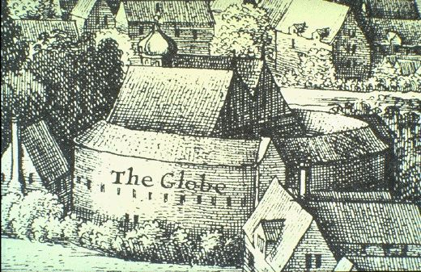
London, 1574
The Globe Theatre

Slide 12
First Folio (1623)

Slide 13
Succession from Edward III until Henry VII

Slide 14
Plantagenets and Roses
EDWARD III (1322-1377) (PLANTAGENET)
______________________________________________________________________________________________
Edward (the Black John of Gaunt Edmund,
Prince) Duke of LANCASTER Duke of YORK
RICHARD II m. Blanche m. Catherine Seynford Richard,
(1377-1399) Earl of Cambridge
HENRY IV John Beaufort
(1399-1413)
HENRY V John Beaufort Richard,
(1413-1422) Duke of York, m Cicely Neville
HENRY VI (1422-1461/1470-1471)
Edward ,Prince of Wales (d.1471) Margaret Beaufort m Edmund Tudor
HENRY VII (1485-1509) TUDOR DYNASTY
_______________________________________________________________________________________________
EDWARD IV Edmund, Earl of Rutland Clarence, Duke of Clarence RICHARD III m. Anne Neville, widow of Edward son of Henry VI
(1461-1483) (1483-1485)
m. Eliz. Woodville
__________________________________________________
Eliz. of York EDWARD V (d. 1483) Richard, Duke of York (d. 1483) Edward, Prince of Wales (d. 1485)
(m. HENRY VII) (TUDOR)
HENRY VIII (etc)

Slide 15
History Plays by Shakespeare
Richard II
Henry IV, part 1 (deposes Richard II) (Lancaster)
Henry IV, part 2 (defeat of rebellions)
Henry V French adventures
Henry VI, parts 1,2,3 (end of Lancasters); murdered by order of Edward IV (York)
Richard III (York)
Henry VIII (Tudor) – no play on Henry VII, first Tudor, king after death of R III at battle of Bosworth Field

Slide 16
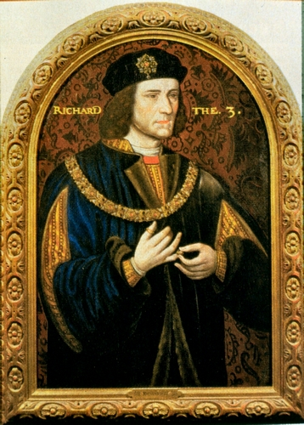
Richard III
Henry VII

Slide 17
SHAKESPEARE
Question of the possibility of hyper-machiavellianism
RICHARD III -- written 1591-1594
General question of using plays
play is the thing
Shakespeare and politics
the times: much like the Renaissance
Inside this a temptation to refuse politics:
Renaissance idyll
Against the golden idyll of As you like it we have a new and pressing concern:
The presence of self-conscious beings who reject that world and use it against itself.
The opening soliloquy
more importantly: he uses the old against itself
a new and fascinating figure: the Machiavellian ( H vi 3: 529)

Slide 18
Richard Gloucester (will become Richard III) in Henry VI, 3, Act III, scene 2
Why, I can smile, and murder whiles I smile, And cry 'Content' to that which grieves my heart, And wet my cheeks with artificial tears, And frame my face to all occasions. I'll drown more sailors than the mermaid shall; I'll slay more gazers than the basilisk; I'll play the orator as well as Nestor, Deceive more slily than Ulysses could, And, like a Sinon, take another Troy. I can add colours to the chameleon, Change shapes with Proteus for advantages, And set the murderous Machiavel to school. Can I do this, and cannot get a crown? Tut, were it farther off, I'll pluck it down.

Slide 19
Richard III, Act I, scene 1
Now is the winter of our discontent Made glorious summer by this sun of York; And all the clouds that lour'd upon our house In the deep bosom of the ocean buried. Now are our brows bound with victorious wreaths; Our bruised arms hung up for monuments; Our stern alarums changed to merry meetings, Our dreadful marches to delightful measures. Grim-visaged war hath smooth'd his wrinkled front; And now, instead of mounting barded steeds To fright the souls of fearful adversaries, He capers nimbly in a lady's chamber To the lascivious pleasing of a lute. But I, that am not shaped for sportive tricks, Nor made to court an amorous looking-glass; I, that am rudely stamp'd, and want love's majesty To strut before a wanton ambling nymph; I, that am curtail'd of this fair proportion, Cheated of feature by dissembling nature, Deformed, unfinish'd, sent before my time Into this breathing world, scarce half made up, And that so lamely and unfashionable That dogs bark at me as I halt by them; Why, I, in this weak piping time of peace, Have no delight to pass away the time, Unless to spy my shadow in the sun And descant on mine own deformity:

Slide 20
And therefore, since I cannot prove a lover, To entertain these fair well-spoken days, I am determined to prove a villain And hate the idle pleasures of these days. Plots have I laid, inductions dangerous, By drunken prophecies, libels and dreams, To set my brother Clarence and the king In deadly hate the one against the other: And if King Edward be as true and just As I am subtle, false and treacherous, This day should Clarence closely be mew'd up, About a prophecy, which says that 'G' Of Edward's heirs the murderer shall be. Dive, thoughts, down to my soul: here Clarence comes.

Slide 21
http://www.youtube.com/watch?v=ke5-SUDrHMU

Slide 22
What is R III about
the power of illusion - S is fascinated with the character -- one of the longest parts in shortest plays; appears all the time.
what if all the world is a stage (or a cave)?
About ties between humans and their lack

Slide 23
What is the role of the Prince in such a world
new problem: who am I when I am not a king: Richard II: abandonment of the notion of kingly right
We shall say:
Richard knows he needs to create a kingdom (stato)
how does he do this?
Opening sol. Renounces love and ties (554)
“I cannot prove lover” but seduces Anne
Uses the energy of others
or again: uses populace for continuity
HAS SUCCESS
problem comes in the exchange with Elizabeth
forced to deny time to make his point even though the consciousness of time in others was what had given him his power
memory comes back: even though the past is an illusion it cannot be gotten rid of
dream sequence
BUT is forced at end to rely on naked strength; having no community with others, he has none with himself.
defeated and sexual and political peace is reestablished
You are what you pretend to be, therefore be careful about what you pretend

