Slide 1
What is a person? When is a person?
The Abortion Cases

Slide 2
Two types of laws
Constitutive
Tempting analogy to chess
Regulative
The function of the Supreme Court
Range of issues on the question of abortion for the public

Slide 3
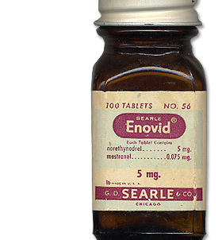
Enovid – approved as contraceptive in 1960; in use for menstrual pains, 1958

Slide 4
First two cases as basis
Griswold v Connecticut (1965)
[Cf Poe v Ullman (1961)\]
Several lines of reasoning
Douglas – relation of husband and wife *(and doctor) is private
What is private?
Idea of the penumbra
Importance of the “sacred” (?) p.5

Slide 5
Goldberg
It is a right
What is a right?
A “trump”?
Harlan:
It is due process
Governmental interference?
Black in dissent
Who is to decide what rights really are
Rochin v California
Stewart: keep philosophy out -dissent

Slide 6
Eisenstein v Baird (1971) extends this to unmarried persons
What happens to the sanctity of marriage argument?
Roe v Wade (1971-3)
Roe had sued on 14th amendment and privacy penumbra grounds
Blackmun
Laws are recent
Prohibition on what grounds?
Right to privacy (even though not mentioned -59)

Slide 7
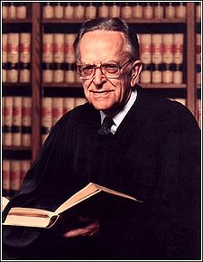
Wade says state has right to protect prenatal life
Blackmun:
What is a person (69)
Makes no distinction of person and human being
But even supposing the fetus is a person…
JJ. Thompson and the violinist
What is life
Precedents?
Leads to three stages theory

Slide 8
Basis of Blackmun’s decision:
No one thinks that abortion is a BENEFIT of pregnancy. That is no one has intercourse in order to have an abortion: Hence for those contemplating an abortion there is suffering.
Medical advances have resolved a number of issues. (Note problems resting a decision on technology)

Slide 9
Webster v Reproductive Health Services (1989)
Court is split with multiple opinions
Missouri Legislature had ruled that
“Life of a human being begins at conception”
Unborn children have protectable interests
State employees were forbidden to perform abortions
State laws should consider viability
Roe is upheld
Scalia says it should be overturned
Violent and bitter dissent from Blackmun

Slide 10
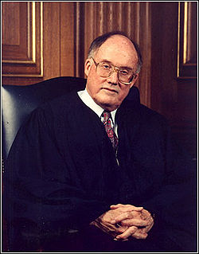
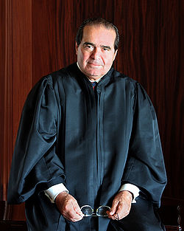
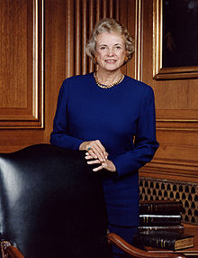
Justice Rehnquist Justice Scalia Justice O’Connor

Slide 11
Planned Parenthood v Casey (1992)
Divided Court (5-4)
Roe is framed in terms of viability
Parameters
Before viability; right to choose
After: state can interfere
O’Connor wants to avoid the “person” debate
Liberty argument
Not moral code

Slide 12
What is this liberty?
Liberty of the woman
Rights of the state
Informed consent
Blackmun: ok but “strict scrutiny” [from footnote 4 to US v Carolene Products (1938), requires:
compelling governmental interest
narrowly tailored
least restrictive means]
Scalia: this is a political question
QUESTION: relation of liberty to equality
Gideon v Wainwright

Slide 13
Other related cases
Homosexualty:
Bowers v Hardwick (1986): sex between consenting men is not legal
Lawrence v Texas (2003): intimate sexual contact is a liberty protected by substantive due process (there is not compelling state interest): (Kennedy reviewed historical evidence)
Abortion related: “Partial birth” (late term)
Stenberg v Carhart (2000): depends on method used: dilation and extraction is not allowed. (question of “fetal pain)
Congress passes a law forbidding “partial birth” abortions (2003)
Gonzalez v Carhart (2006) upholds Congressional ban.
Procedure is not related to woman’s health. State can enforce substantive concerns for the fetus at all times providing they do not produce an undue burden on the woman.

Slide 14
Some considerations
Being human and being a person
What in the society in which we live makes an unwanted child a problematic matter?
What is free choice in the world in which we live?

