Slide 1
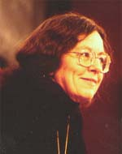
Hanna F. Pitkin

Slide 2
Hanna F. Pitkin: OBLIGATION AND CONSENT
Consent Theory: sources
God, Hobbes, Locke, Rawls
Pitkin and the doctrine of “hypothetical consent
Methodology
What “people really do”
Socrates and the Nazi official
procedural and substantive criteria
What are real choices?

Slide 3
The use of examples
important that there are lots of different cases
who thinks of consent
not the blacks, the civil disobedient
but Socrates and the official
but the official gives us pause about resting things on consent
Socrates: here he accepts his obligation to remain but he as also disobeyed: how does he know to what he has consented
Cannot be tacit (how would we know) 19
this cannot be a matter of what the majority thinks (but what the majority thinks a matter to consider
although this can be evidence (20)

Slide 4
How do we assess a government?
Two forms for assessing government
procedural (rules followed)
substantive (people well treated)
BUT: p 44
idea of the grammar of the word ‘obligation’
suppose I ask why are you ever obliged to obey even legitimate authority --- traditional consent theory takes this for granted: confuses the self assumption of contract with the self assumption of obligation (23)

Slide 5
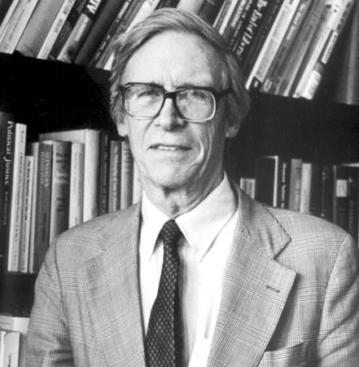
JOHN RAWLS and STANLEY CAVELL

Slide 6
The “grammar” of consent
The case of promising
The place of promising: Rawls and Cavell
Deontology
Right intentions
Teleology
What is a duty to do
“We” and our obligations
who is to say?

