Slide 1
John Stuart Mill
1806-1873
James Mill: 1773-1836 (father)
Bertrand Russell: 1872-1970 (JSM’ s godson)

Slide 2
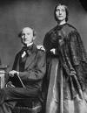

Slide 3
Biography
Education at home ; IQ ;Harriet Taylor (married in 1851) ; ; Parliament (women’s suffrage ; working class interest ; land reform in Ireland)
Utilitarianism
Act
Rule
Mill principle of liberty
“That principle is, that the sole end for which mankind are warranted, individually or collectively, in interfering with the liberty of action of any of their number, is self-protection. That the only purpose for which power can be rightfully exercised over any member of a civilized community, against his will, is to prevent harm to others. His own good, either physical or moral, is not a sufficient warrant. He cannot rightfully be compelled to do or forbear because it will be better for him to do so, because it will make him happier, because, in the opinions of others, to do so would be wise, or even right. …” OL part I

Slide 4
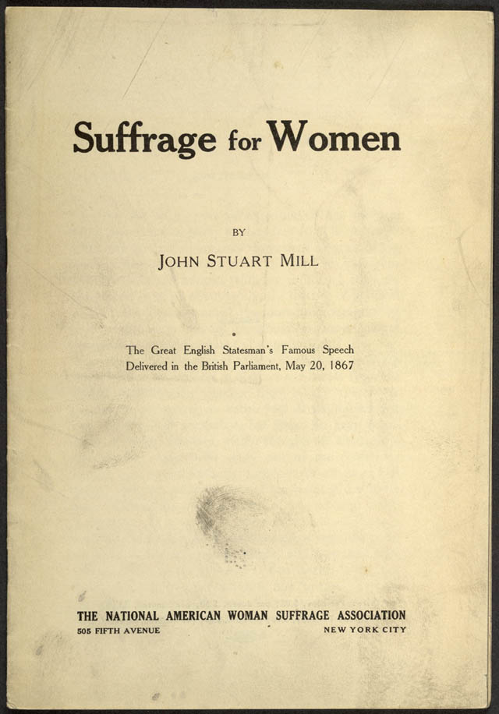

Slide 5
On Liberty
Chapter One
New topic
society now the problem
Old struggle
Purpose of Essay
Civilized community(?)
Utility in the largest sense
consciousness]
Plan of our life
Combine with others

Slide 6
Chapter Two
No silencing of an opinion
Truth of an opinion is part of its usefulness
Summary
Politics
Not infallible
Collision
Real
Inner self

Slide 7
Chapters Three and Four
Three
Individuals and the crowd
Regularity of conduct
Human progressiveness
Four
But no one is completely isolated: problem with the “harm principle” (Chapter 1)
Self-regarding vs other-regarding
“distinct and assignable obligation”
Does this work (examples)
Paternalism
Security?

Slide 8
Chapter Five
Applications
Why restrict government interference?
Maxims
Cases
What about agreements with others that affect only you?
Slavery
Marriage
Democratic conviction: the cost of liberty

Slide 9
questions
People may say:
What is harm to others
Eg drugs
Is this physical damage or moral harm
Nudity
Is there really a self regarding vs other-regarding interests( a criticism raised from the beginning)

Slide 10
“man as a progressive social being’
`NOT A QUESTION OF SUBSTANCE
this means in the end being open ended
Autobiography V:
If I am asked, what system of political philosophy I substituted for that which, as a philosophy, I had abandoned, I answer, no system: only a conviction that the true system was something much more complex and many-sided than I had previously had any idea of, and that its office was to supply, not a set of model institutions, but principles from which the institutions suitable to any given circumstances might be deduced.

