Slide 1
Structuring through power
Bruno Bettelheim, 1903-1990
Michel Foucault,
William Connolly

Slide 2
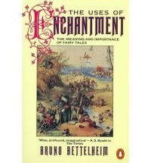

Slide 3
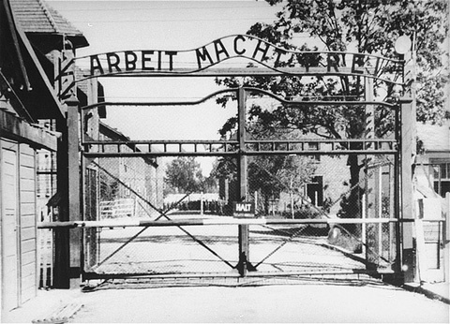
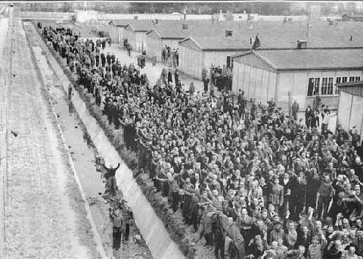
Bruno Bettelheim

Slide 4
What can the structuring of the environment do?
Bettelheim’s Three Theses
1. the exercise of power can break down “normal” human relations
2. Nazis had a purpose in being brutal
3. the “Lutheran thesis”

Slide 5
Symbolic Acts (from E. Goffman, Asylums)
1. need to make sense
2.desire to attach meaning

Slide 6
“Moral Career” of the Inmate
Structure of camp
Total institution
Steps
Entry
Practices
Generally
Disruption of actor to acts
Disruption of relation to external world
Disruption of choice
Translation of meaning of actions

Slide 7
Implications Consequences
Implications
Consequences
Withdrawal
Intransigence
Colonization
Conversion
Bettelheim’s “solution”

Slide 8
Moral Career of Staff
“The longer you look into an abyss, the more it looks back at you”
Attitude towards inmates
Technical necessity standards
Acceptance of institutional standards

Slide 9
William Connolly (1938 --) and Michel Foucault
The above is extreme –how about closer to us
External Structures of disciplinary constraint
Egs
Do these work?
Can they be made internal also?
Looks at Michel Foucault

Slide 10
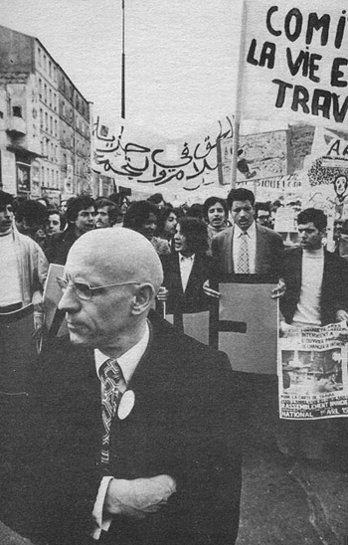
Foucault

Slide 11
Background and bio
History of Madness
Discipline and Punish
Criminility in Later Middle Ages
Public execution
Criminality more recently
Techniques of control
Observation
Normalizing judgment
Examination
Fields of documentation

Slide 12
PANOPTICON;
OR
THE INSPECTION-HOUSE:
CONTAINING THE
IDEA OF A NEW PRINCIPLE OF CONSTRUCTION
APPLICABLE TO
ANY SORT OF ESTABLISHMENT, IN WHICH PERSONS OF
ANY DESCRIPTION ARE TO BE KEPT UNDER INSPECTION;
AND IN PARTICULAR TO
PENITENTIARY-HOUSES,
PRISONS, HOUSES OF INDUSTRY, WORK-HOUSES, POOR-HOUSES, LAZARETTOS, MANUFACTORIES, HOSPITALS, MAD-HOUSES, AND SCHOOLS:
WITH
A PLAN OF MANAGEMENT
ADAPTED TO THE PRINCIPLE:
IN A SERIES OF LETTERS,
WRITTEN IN THE YEAR 1787, FROM CRECHEFF IN WHITE
RUSSIA. TO A FRIEND IN ENGLAND
BY JEREMY BENTHAM,
OF LINCOLN'S INN, ESQUIRE.

Slide 13
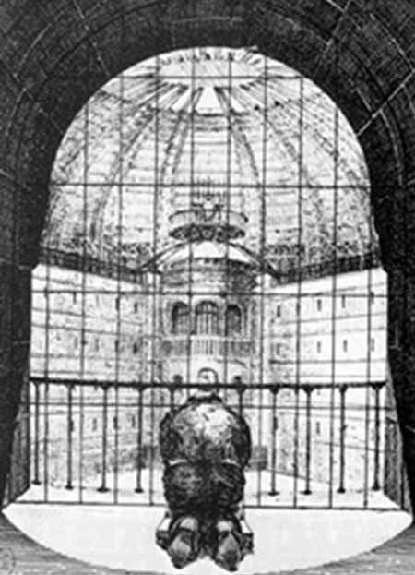

Slide 14
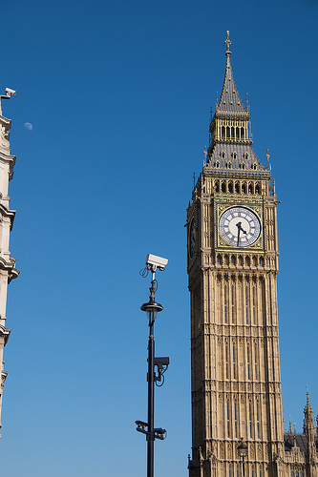

Slide 15
Are there alternatives?
1. is this too bleak?
2. reflexivity
Limits of ones own categories
Should we aim for a rational solution
3. the fixed self and the enemy
4. Connolly and “slack”

Slide 16
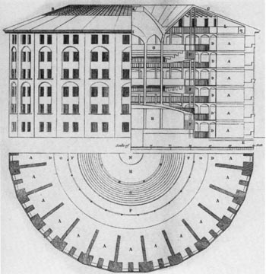
Panopticon (Bentham)

Slide 18
What can the structuring of environment do?
T

