Slide 1
LATI 50
REVIEW AND OVERVIEW
Winter 2015

Slide 2
Why Latin America?
It’s big
It’s there
It’s here
It’s a mirror
It’s a paradox

Slide 3
Why Latin America?
It’s big
It’s there
It’s here
It’s a mirror
It’s a paradox

Slide 4
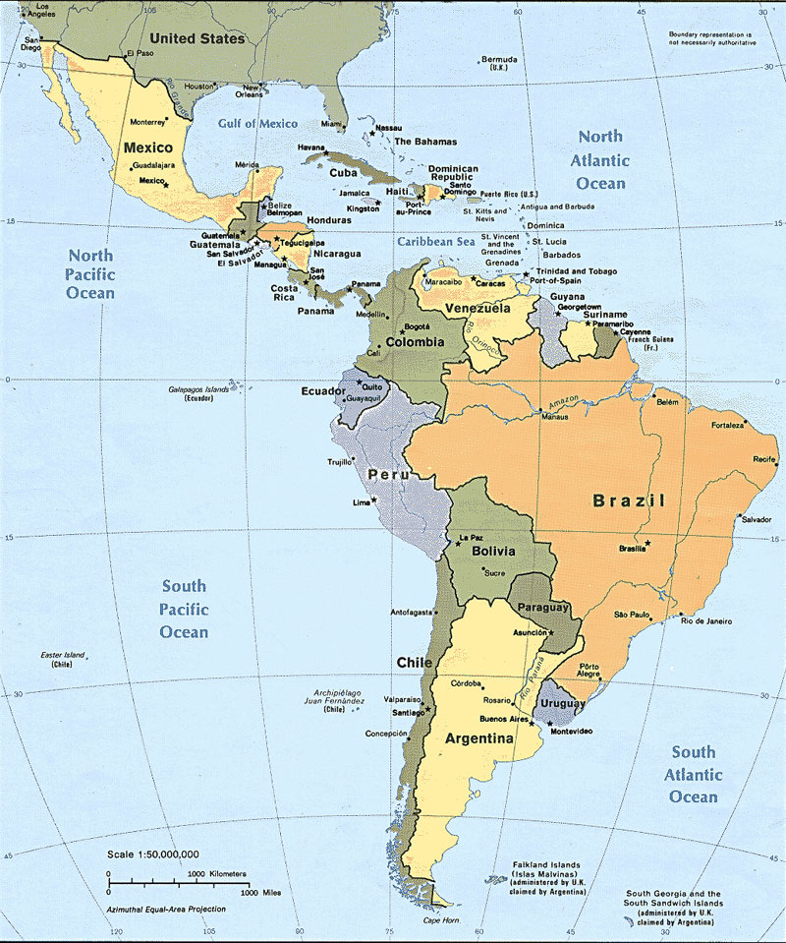

Slide 5
Elements of Paradox
Old-young, unstable-stable, rich-poor
Gender
Sports/Baseball
Religion
Politics
Literature

Slide 6
Elements of Paradox
Old-young, unstable-stable, rich-poor
Gender
Sports/Baseball
Religion
Politics
Literature

Slide 7
Points of Entry
Readings in Modern Latin America, 8th ed
Fiction: García Márquez
Videos:
“Garden of the Forking Paths”
“Mirrors of the Heart”
“In Women’s Hands”
“Builders of Images”
“The Americans” [Latin and Caribbean Presence in U.S]
Original documents (MLA website)

Slide 8
Course Organization (I)
1: Introduction
Why Latin America?
Why History?
2: Dimensions of History
Confronting the United States [Mexico+ Cuba]
How to Read Modern Latin America
3: A World of Multiple Truths: Magical Realism
Writers and Society [Puerto Rico]
A Death Foretold: Motifs and Allusions [Colombia]
4: Economic Development
From Export-Import Development to ISI [Argentina]
Neoliberalism and the Washington Consensus [Chile]

Slide 9
Course Organization (II)
5: Democracy and Dictatorship
Authoritarianism and Democracy [Latin America as whole]
Revolution: Why Then and Not Now? [Cuba + Central America /Venezuela]
6: Society and Social Movements
Race, Class, and Social Structure (part I) [Bolivia, Andes]
Race, Class, and Social Structure (part II) [Dominican Republic, Caribbean]
Women, Gender, and Empowerment [Chile]
Religion, the Church, and Liberation Theology [Colombia]
Culture and the Arts [Mexico + Brazil +]

Slide 10
Course Organization (III)
7: Inter-American Agenda
The Political Economy of Drugs [Mexico, Colombia, United States]
Immigration Policy [Florida, New York, California]
Obama and Latin America
8: Review and Overview

Slide 11
Some Central Themes
Power and Inequality
Formal and informal: social, economic, political
Politics and social class
Correlates of Race
Codes of Social Conduct
Hierarchy vs. social mobility
Gender and sexuality
Meanings of status and “honor”
Commitment and responsibility
Sources of moral authority
Roles of Institutions
Religion and the Church
The state, the military, revolutions, and elections
Art and Social Protest
The quest for identity
Art and the masses
Art as subversion

Slide 12
¡Adelante!

