Slide 1
Basic charts from the last UC Budget Comment: The charts do not reflect the big cut in 2009
Source: http://budget.ucop.edu/rbudget/200910/2009-10BudgetforCurrentOperations-BudgetDetail.pdf

Slide 2
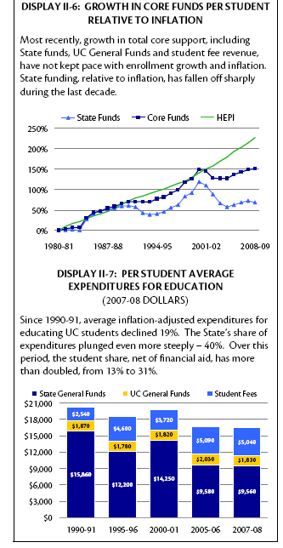
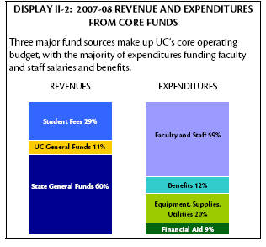
The Funding of UC
UC Core Funds
The University’s “core funds,” comprised of State General Funds, UC General Funds, and student fee revenue, provide permanent support for the core mission activities of the University: instruction, research, and public service, as well as the administrative and support services needed to carry out these activities. Totaling $5.6 billion in 2008-09, these funds represent 28% of the University’s total budget.
UC General Funds
In addition to State General Fund support, certain other fund sources are unrestricted and provide general support for the University’s core mission activities. Collectively referred to as UC General Funds, these include:
- a portion of overhead on federal and state contracts and grants;
- DOE laboratory operations overhead and management;
nonresident tuition;
fees for application for admission and other fees;
a portion of patent royalty income; and
interest on General Fund balances.
Based on recent trends and nonresident enrollment projections and tuition levels, the University expects to generate $594 million in UC General Funds during 2008-09. The largest sources of UC General Funds are nonresident tuition, accounting for $257 million, and indirect cost recovery on federal contracts and grants, totaling $252 million in 2008-09.
HEPI=Higher Education Price Index
Comment: In the chart to the left student fees are net of financial aid.

Slide 3
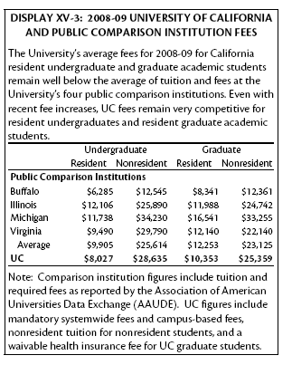
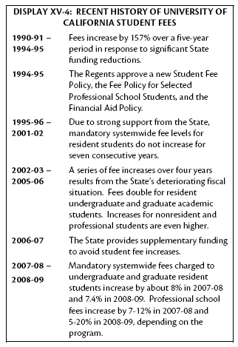
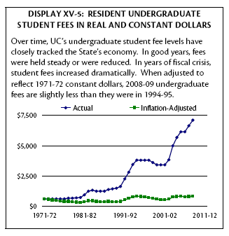
Student Fees

Slide 4
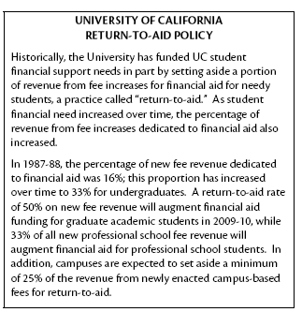
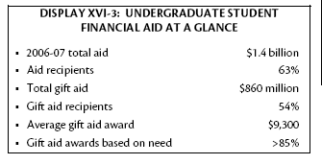
Return-to-Aid
Comment: Aid includes loans and gift aid.

Slide 5
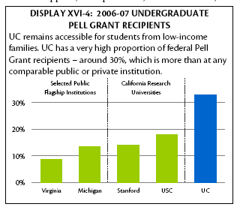
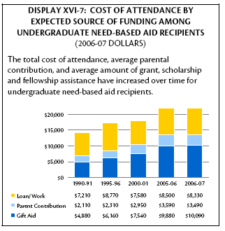
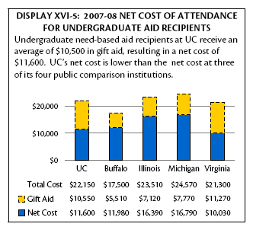
Access
the total cost of attendance:
resident student fees,
living and personal expenses,
costs related to books and supplies,
transportation,
health care

Slide 6
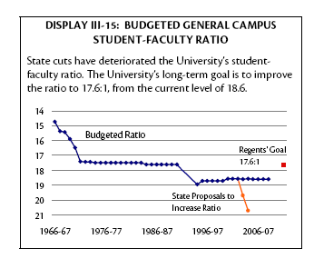
Student-Faculty Ratio
Since 1994, the University has maintained a budgeted student-faculty ratio of 18.6:1. Before the cuts of the early 1990s, the University’s student-faculty ratio was 17.6:1; the deterioration in the ratio represented about 500 faculty members.

Slide 7
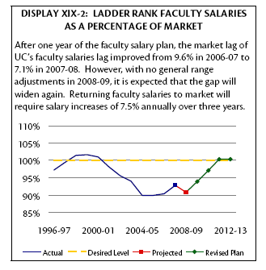
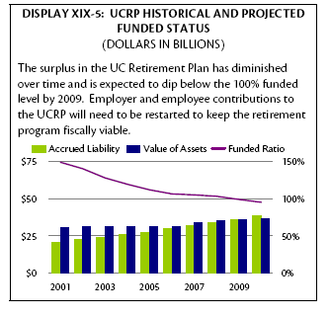
Faculty Pay and Pension
Comment: This does not reflect the 2009 cut
Comment: This chart was compiled around October 2008 and it does not reflect recent losses.

Slide 8
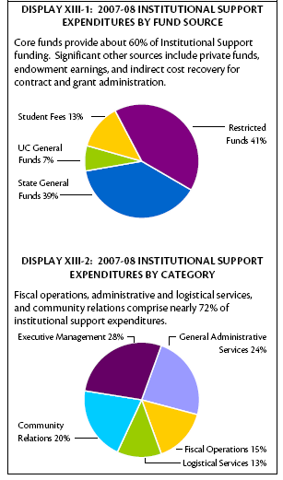
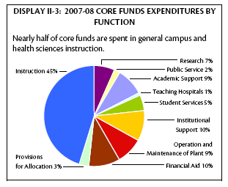
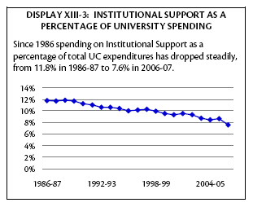
Administration (Institutional Support)
Comment: The text indicates elsewhere that the budget of UCOP is around 280 million (p.107). Of that 57 million is being cut but 26 million of the cut is redirected to the campuses.
Institutional Support
Services provide the administrative infrastructure for the University’s operations. Grouped into five broad categories, institutional support activities include:
- Executive Management — offices of the President, Vice Presidents, Chancellors, and Vice Chancellors; planning and budget offices;
- Fiscal Operations — accounting, audit, and contract and grant administration;
- General Administrative Services — computer centers, information systems, and personnel;
- Logistical Services — purchasing, mail distribution, and police;
Community Relations — development and publications.
Comment: Institutional Support does not include academic support or operation and maintenance of plant.

